Slide 1


  TUES, JUNE 11
(DAY 79; 2 CLASS DAYS LEFT)

Slide 2

Did You Know?
the word 'almost' is the longest in the English language with all the letters in alphabetical order

Slide 3

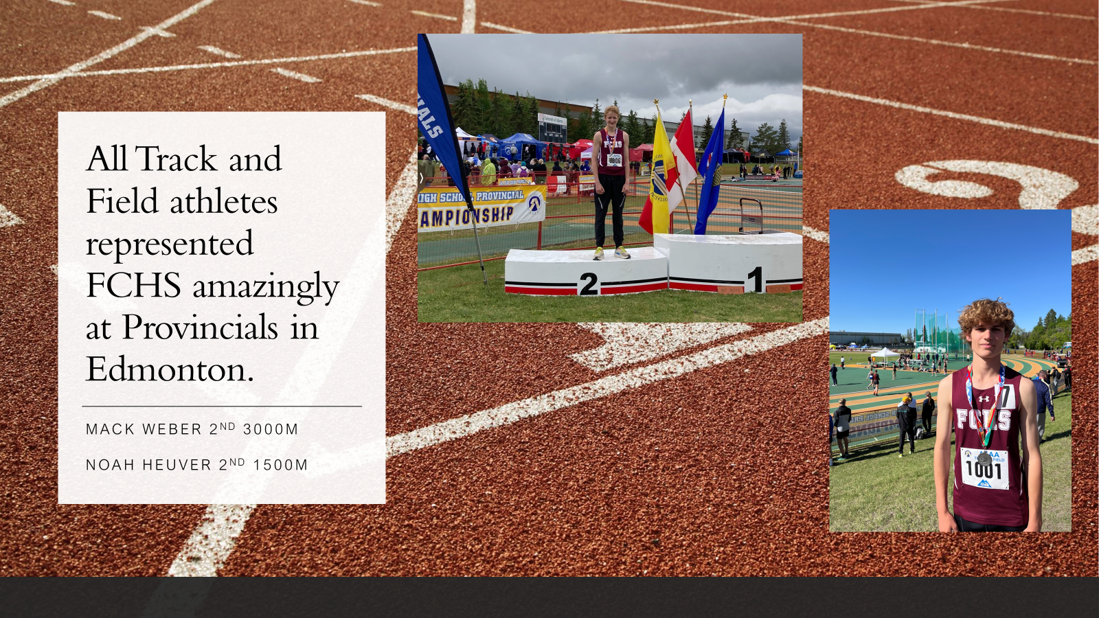
TRACK PROVINCIALS
SPORT

Slide 4

FALCONS ATHLETIC BANQUET
When? JUNE 20, 5:00pm
Where? FCHS LARGE GYM
Who? All Athletes and parents who want to come.
How? Each athlete has already paid for a ticket. Tickets for guests must be purchased ($30) in the cafeteria OR at the office.
SPORT

Slide 5

Did You Know?
atychiphobia is the fear of failure

Slide 6
GENERAL

Slide 7

GENERAL

Slide 8
TAKE PRIDE IN YOUR SPACE!!
GOOD=Don’t litter
BETTER=Tell others
not to litter
BEST=Pick up ONE piece of
garbage every day and
throw it in the bins.
GENERAL

Slide 9
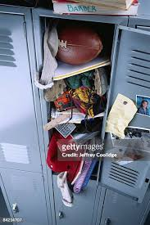
LOCKERS
Need to be cleaned out by JUNE 12
(or all your possessions will be donated by JUNE 20)
PLEASE LEAVE
THE LOCKS ON
THE LOCKERS
(LOCKED)
(SCHOOL AND GYM)
GENERAL

Slide 10

TEXT BOOKS:
Please return all library books.
BRING BACK TEXT BOOKS BEFORE OR ON THE DAY OF YOUR EXAM.
GENERAL

Slide 11
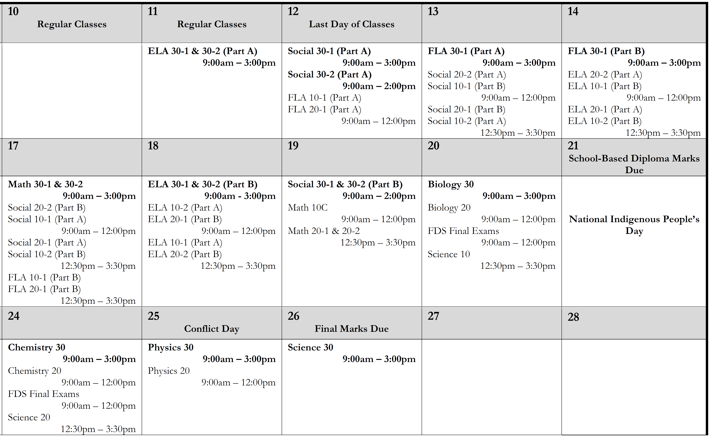
FINAL EXAM SCHEDULE
GENERAL

Slide 12

GENERAL

Slide 13

GENERAL

