Slide 1
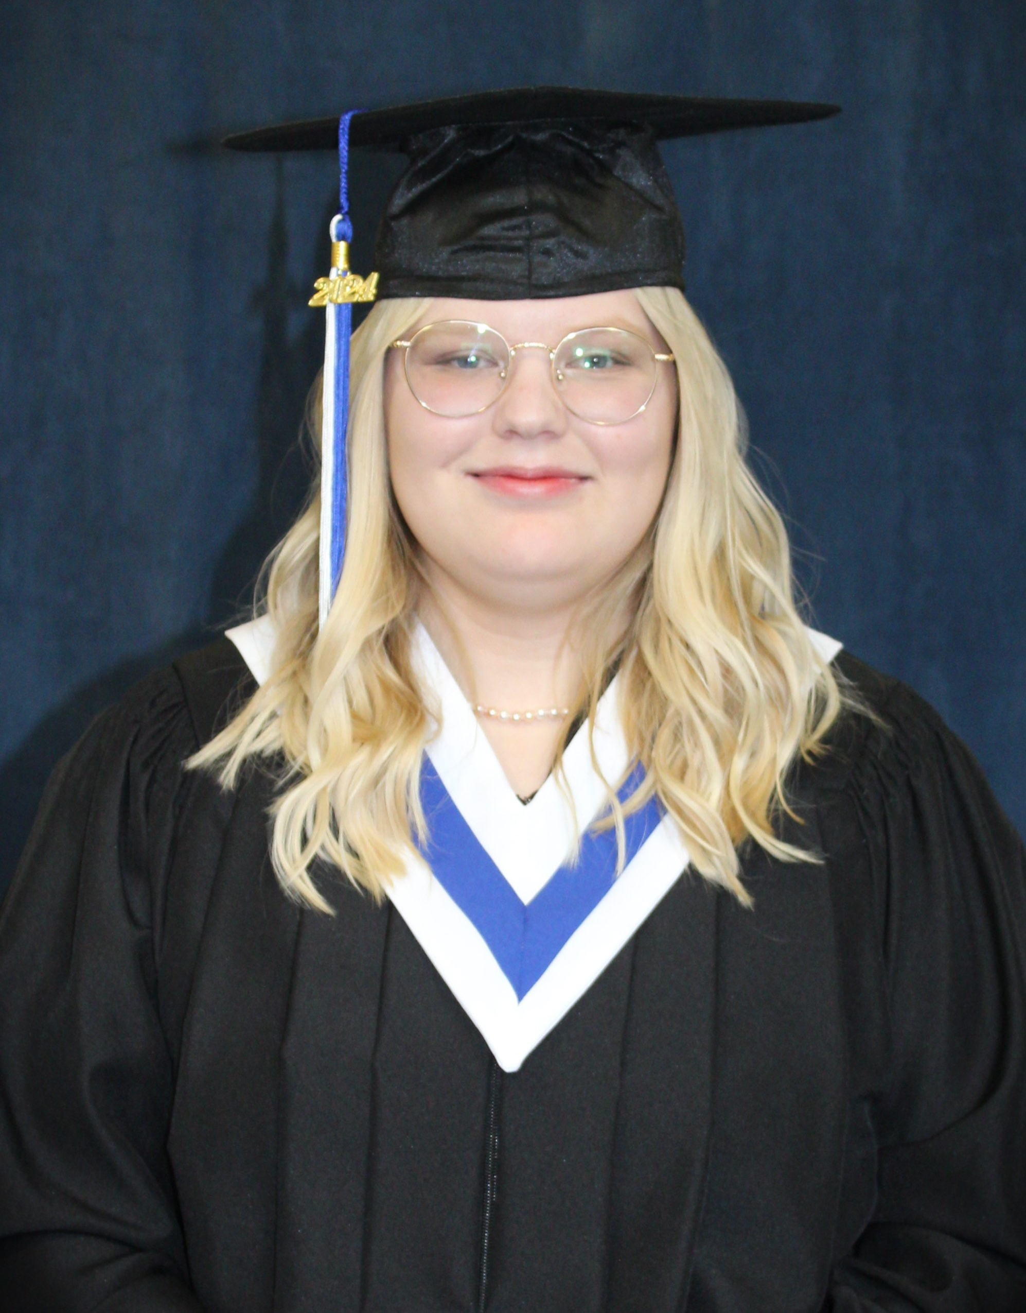
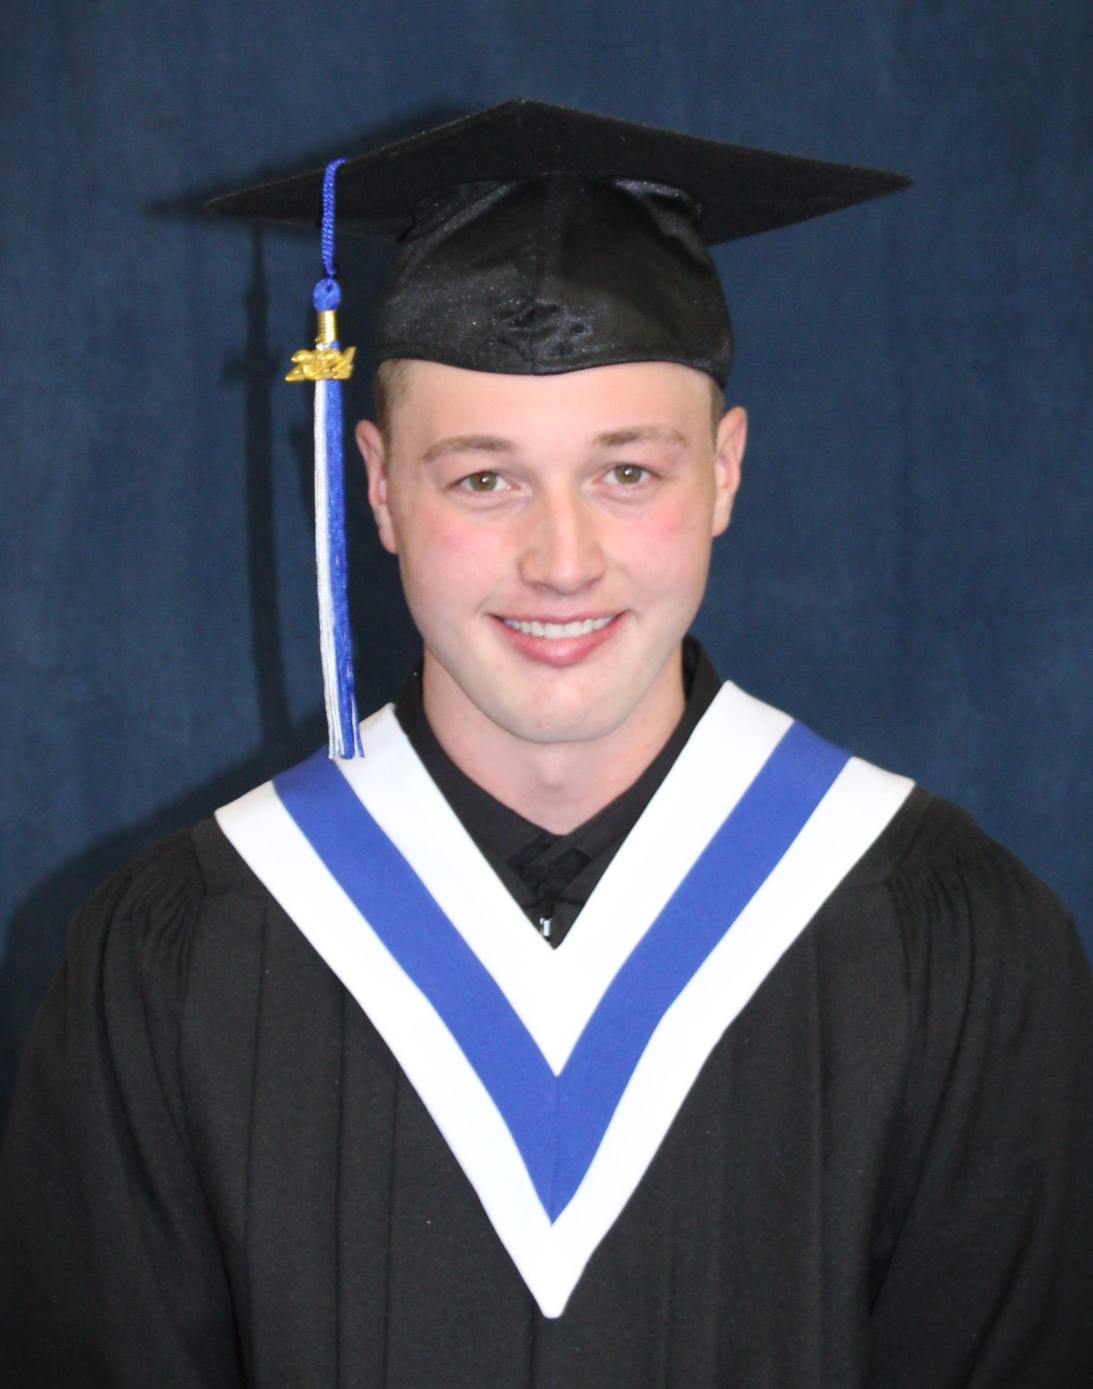
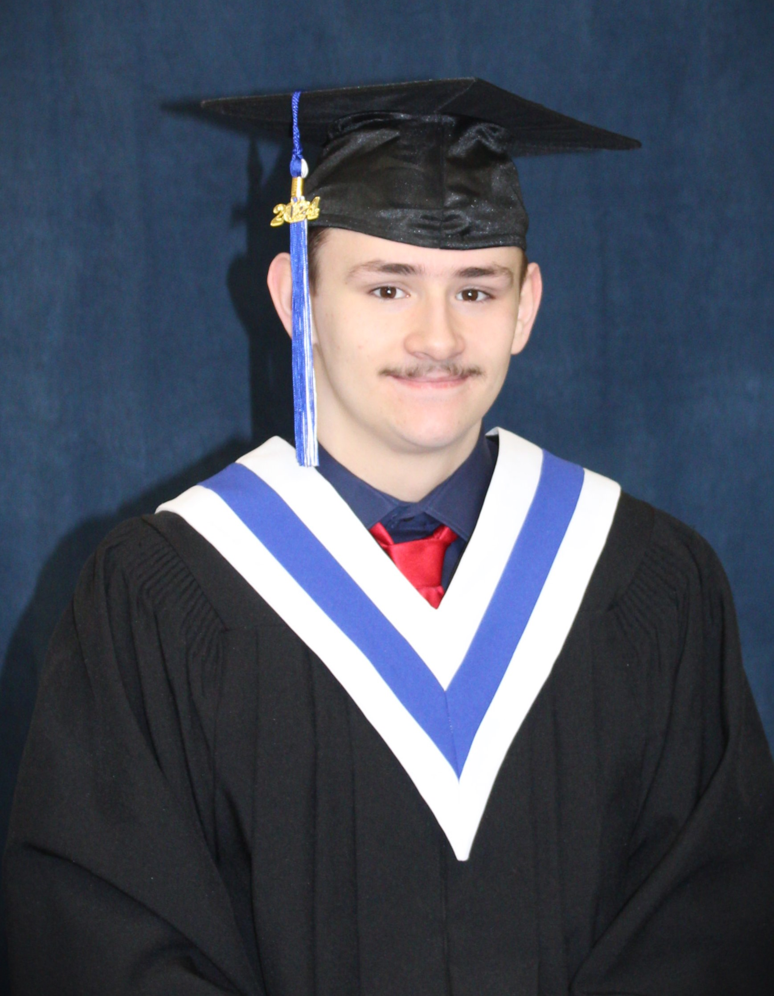
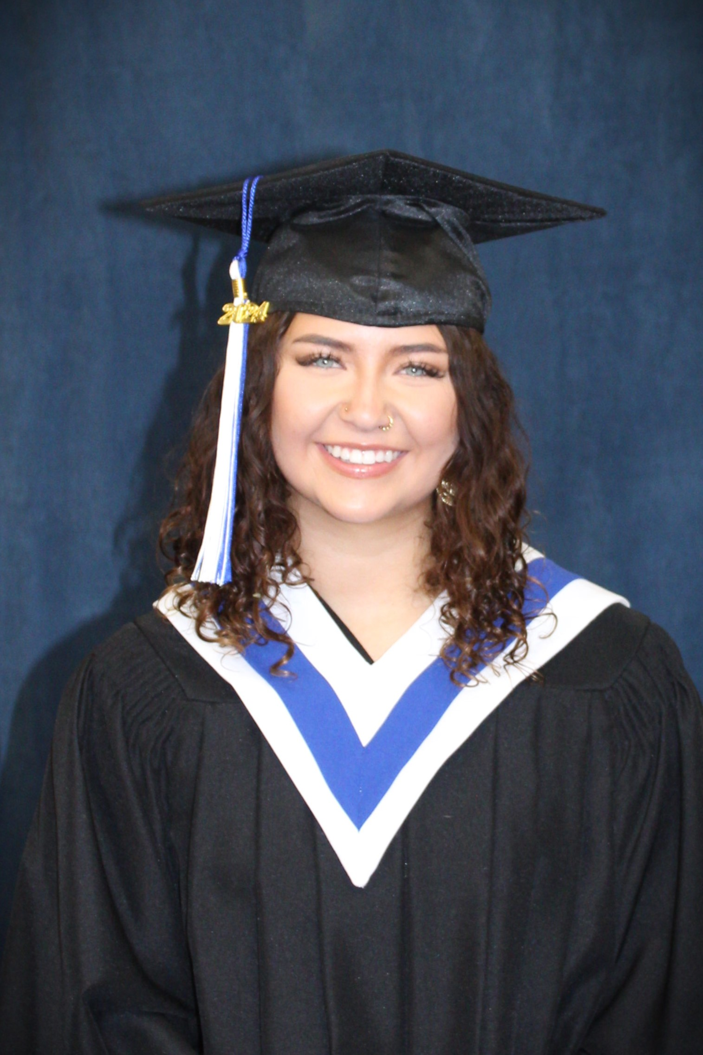
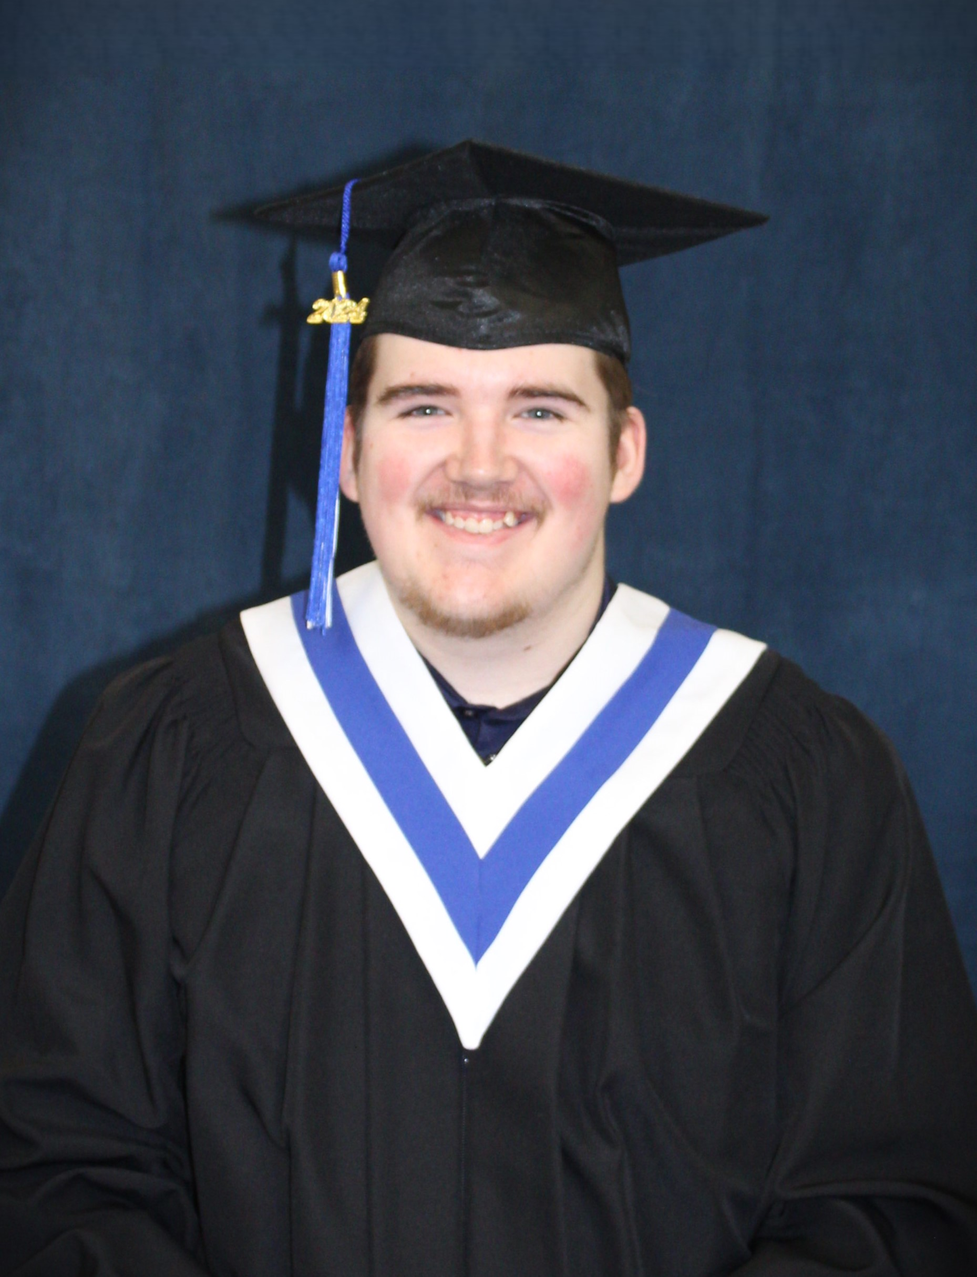
AURORA
TANNER
AIDAN
OLIVIA
ARNIKO

Slide 2
Our graduates have worked very hard over the past few years, overcoming many obstacles and showing great resiliency in the pursuit of their diploma and life goals. We wish them all the best and would like to extend an open invitation for all them to come by and visit at any time. Way to go class of 2024!
As we reach the conclusion of the school year, I would like to compliment the students on the hard work they have shown throughout the year. Congratulations to our students who successfully completed their required core courses. Physical Education, Yoga, Art and Foods provided our students with great option choices, the students participating in them have been very successful. Congratulations to our five graduating students, all your hard work paid off, I am very proud of you. Have a great summer!!!

Slide 3
Dear Cameron Crossing families,
What a wonderful, wild ride this school year has been. New staff, new students, new program, and new spaces on the horizon. There have been many highlights from this year, from the development of our PECC parent and caregiver council and our first ever Student Council, to the many engagement and volunteer hours students
put in at Millerville Christmas Market, Town of Okotoks Seniors Luncheon, Students Matters, Foothills Mental Health Summit, and many more. And of course, the culmination of the accomplishments of our grade 12s with our graduation ceremony. All of our students have demonstrated resiliency and grace as we navigated new and changing waters together. There is a Blackfoot saying, Aahsa kitsikimmoki? or What is it that cares for you? The Cameron Crossing family, as we who were new this year learned of and felt its warm embrace, cares for us. Thank you.
We look forward to continuing to learn and grow alongside you all next year. In the meantime, from all of our Cameron Crossing staff: have a wonderful, restful, and safe summer. Principal ~ Ms. Monica Crane
Please feel free to follow the CC family and join Cameron Crossing School’s Instagram account: @cameron.crossing.school It’s a great way to celebrate all the fantastic participation from our students & staff!
Cameron Crossing School also has a webpage through the Foothills School Division. Check it out at: www.foothillsschooldivision.ca/cameroncrossing
Instagram:
@cameron.crossing.school

Slide 4
It is hard to believe that we are at the end of the school year! As we soak up the sun and enjoy our summer break, let's also remember to take care of ourselves. Remember, taking care of your mental health is important year
round, including during the summer months, see you in the fall.
Get Outside: Take advantage of the longer daylight hours and sunshine by spending time outdoors. Vitamin D from sunlight can help improve mood.
Stay Active: Engage in physical activities you enjoy, whether it's swimming, hiking, biking, or playing sports. Exercise releases endorphins that boost mood and reduce stress.
Practice Mindfulness: Use the summer downtime to practice mindfulness or meditation. It can help calm the mind, reduce anxiety, and improve overall well-being.
Stay Hydrated: Drink plenty of water throughout the day to stay hydrated. Dehydration can affect mood and cognitive function.
Maintain a Routine: While it's tempting to sleep in and stay up late during summer, try to maintain a regular sleep schedule. Sufficient sleep is crucial for mental health.
Connect with Others: Spend time with friends and family, whether it's through outdoor activities, gatherings, or virtual meetups. Social connections are vital for mental health.
Limit Screen Time: Balance screen time with outdoor activities and face-to-face interactions. Too much screen time can contribute to feelings of isolation and impact sleep quality.
Set Realistic Goals: Use the summer to set and achieve personal goals, whether they're related to hobbies, fitness, or self-improvement. Accomplishments boost self- esteem and motivation.
Seek Help if Needed: If you're struggling with your mental health, don’t hesitate to reach out to a trusted friend, family member, or mental health professional for support.
Enjoy the Moment: Finally, savor the simple pleasures of summer.

Slide 5
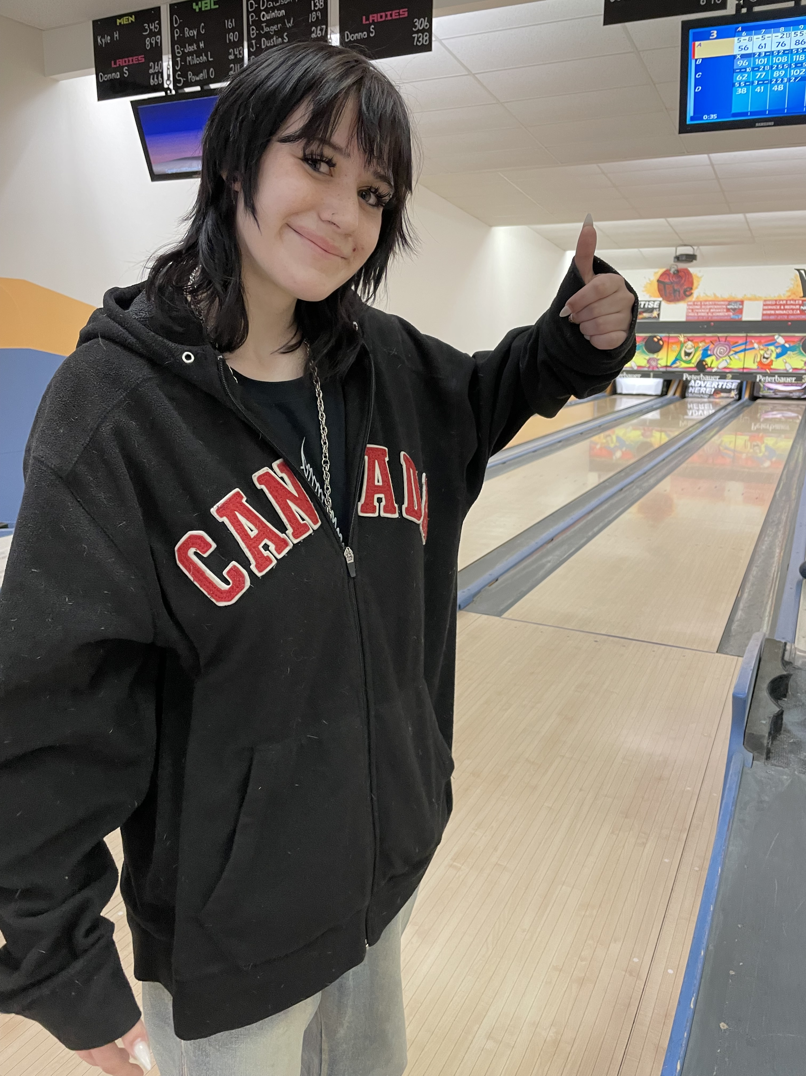
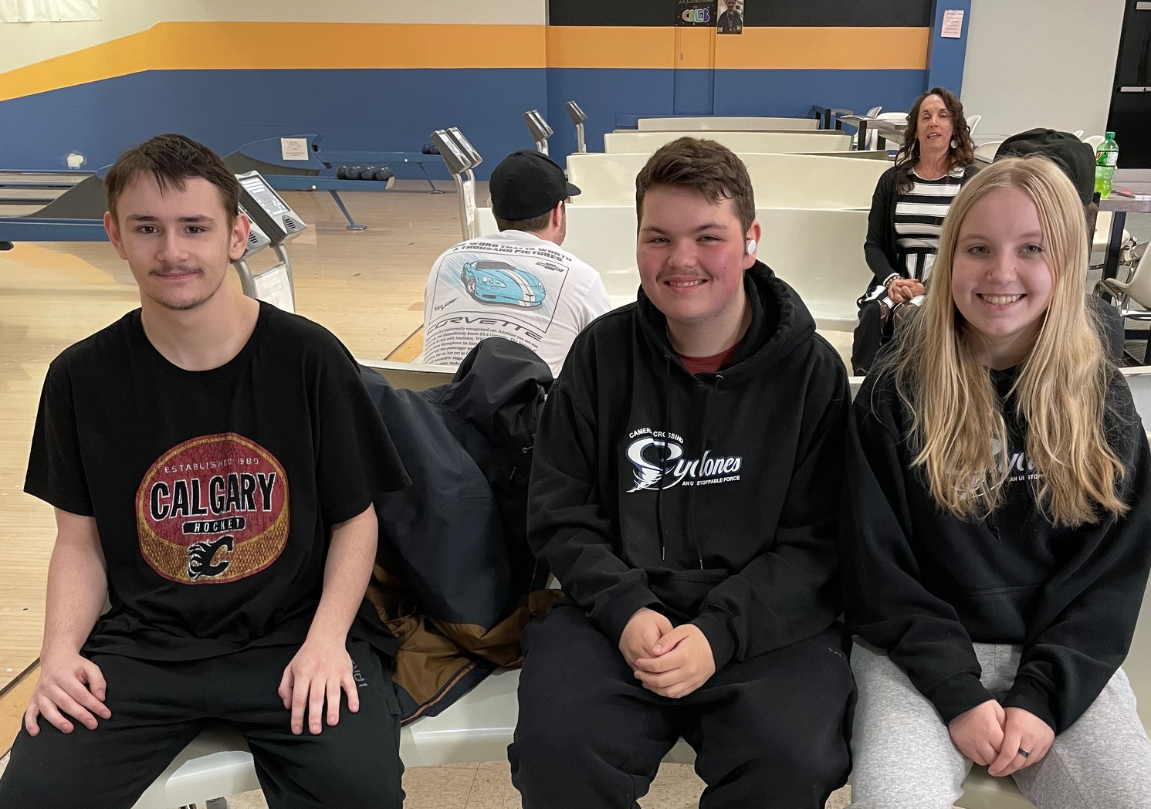
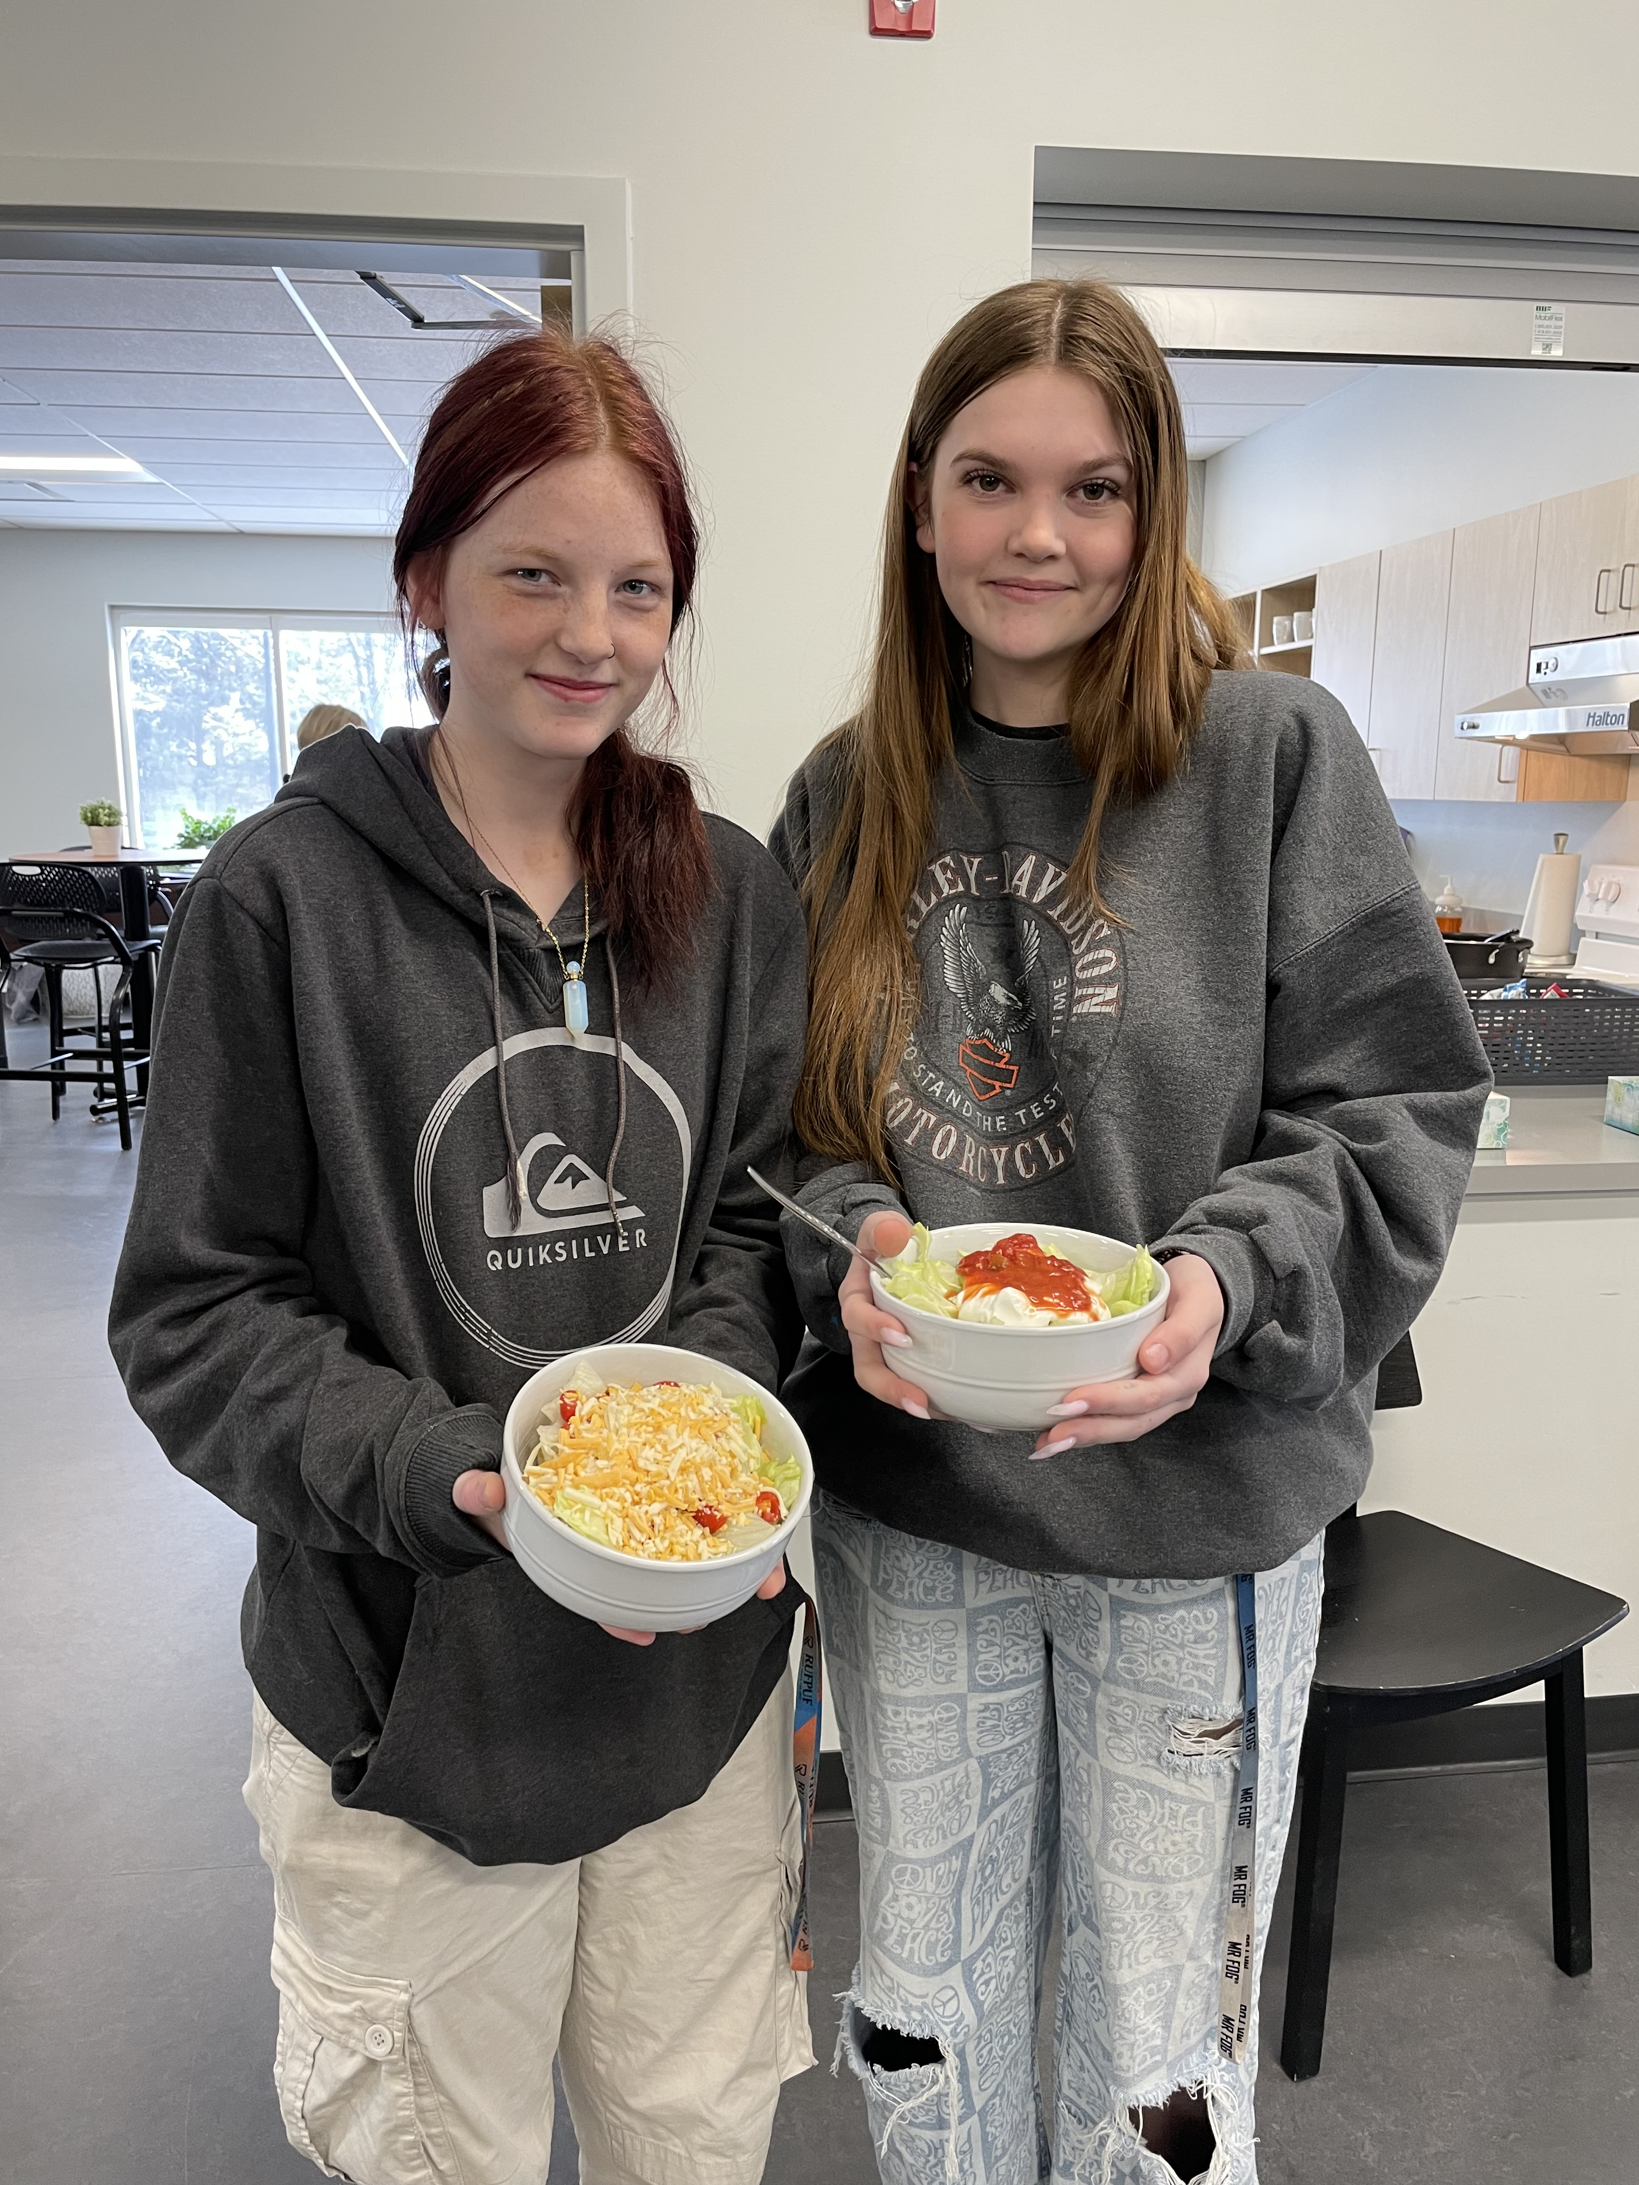
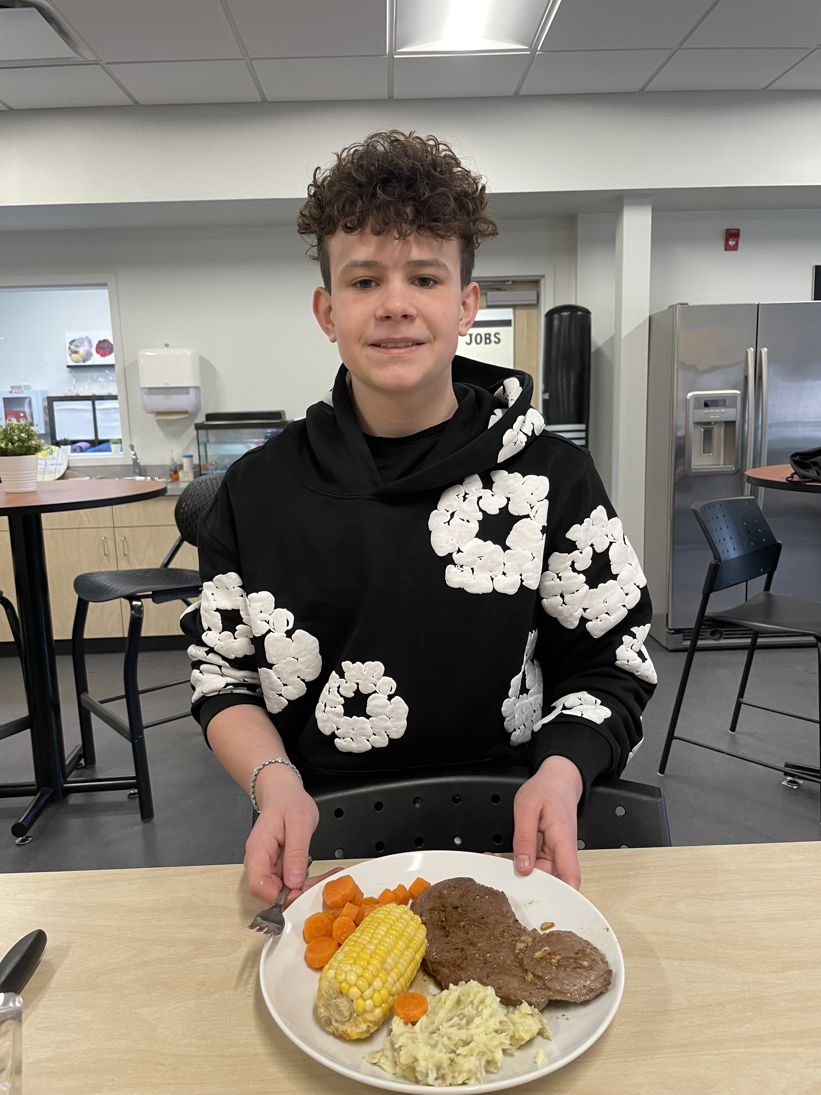
As we reach the end of another incredible year, we want to take a moment to congratulate each and every one of you on fostering such a wonderful school culture. Your enthusiasm, kindness, and dedication have made our school a vibrant and welcoming place for all.
From the spirited participation in events to the everyday acts of support and friendship, you have shown what it means to be part of a truly exceptional community. Your hard work, creativity, and positive attitudes have not only shaped our school environment but have also set a remarkable example for others to follow.

Slide 6
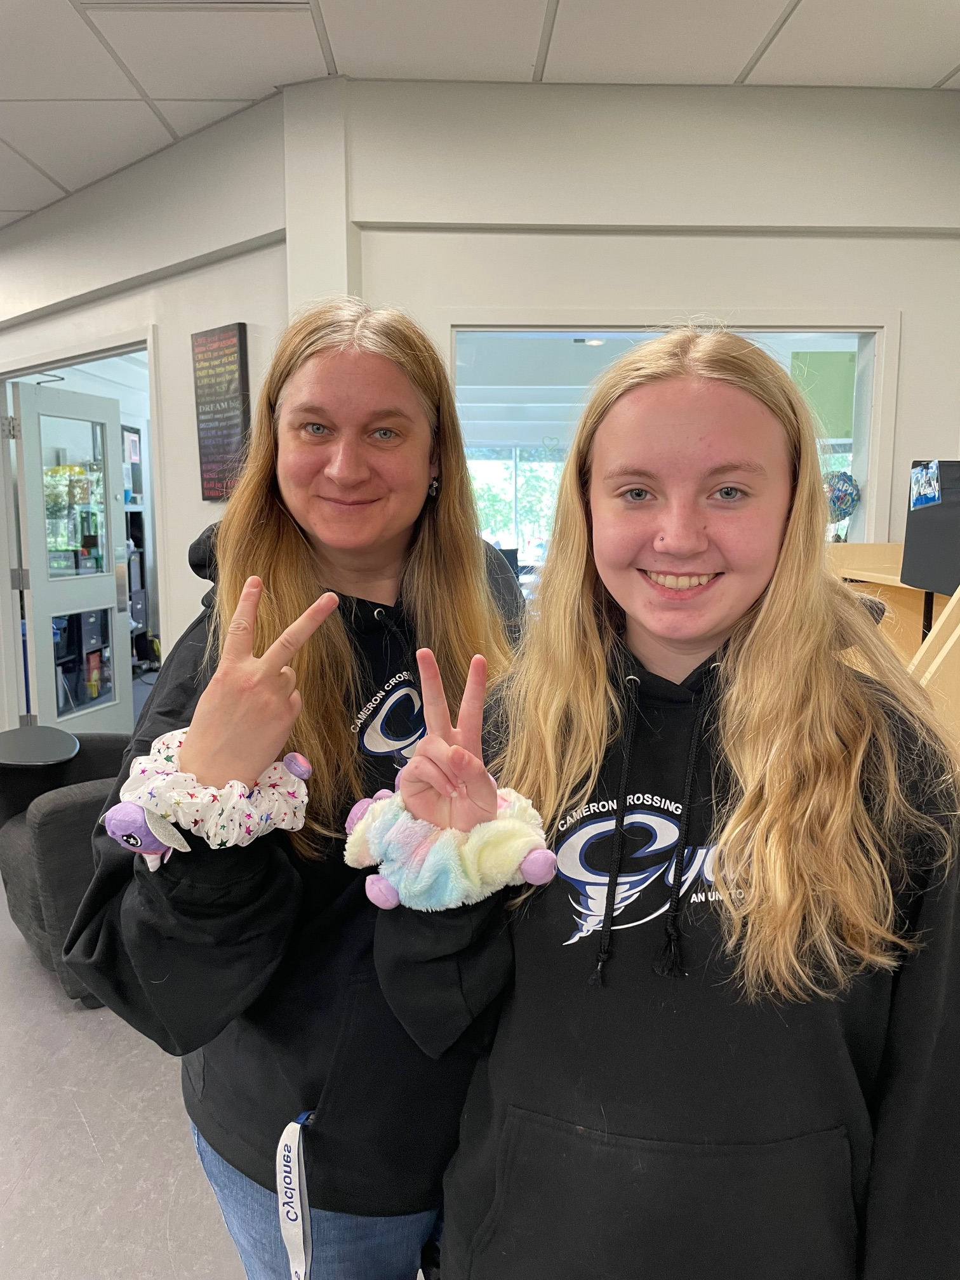
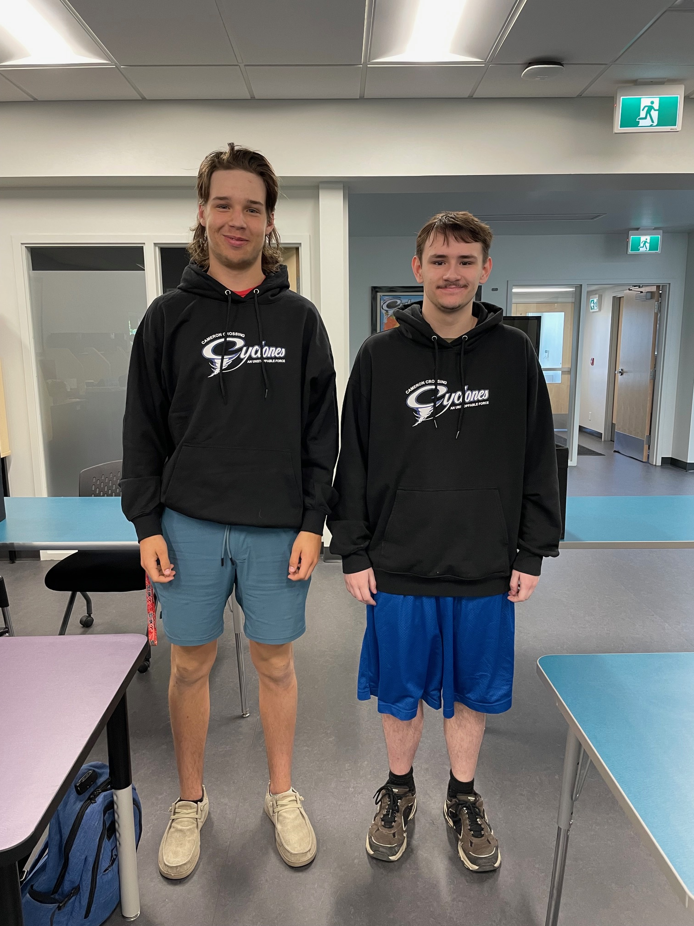
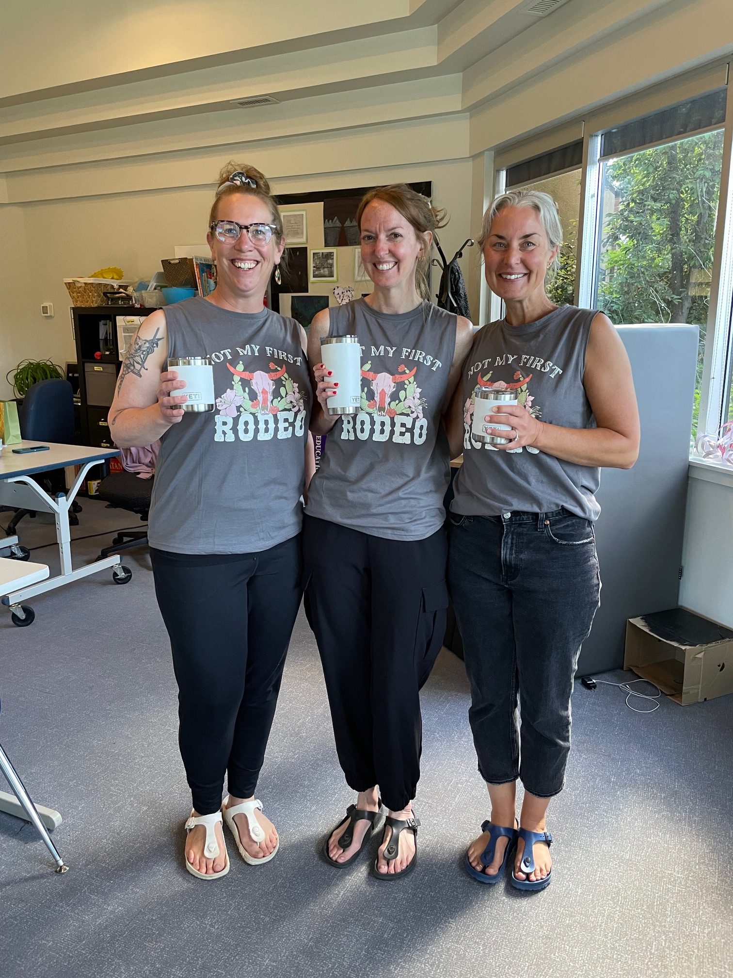
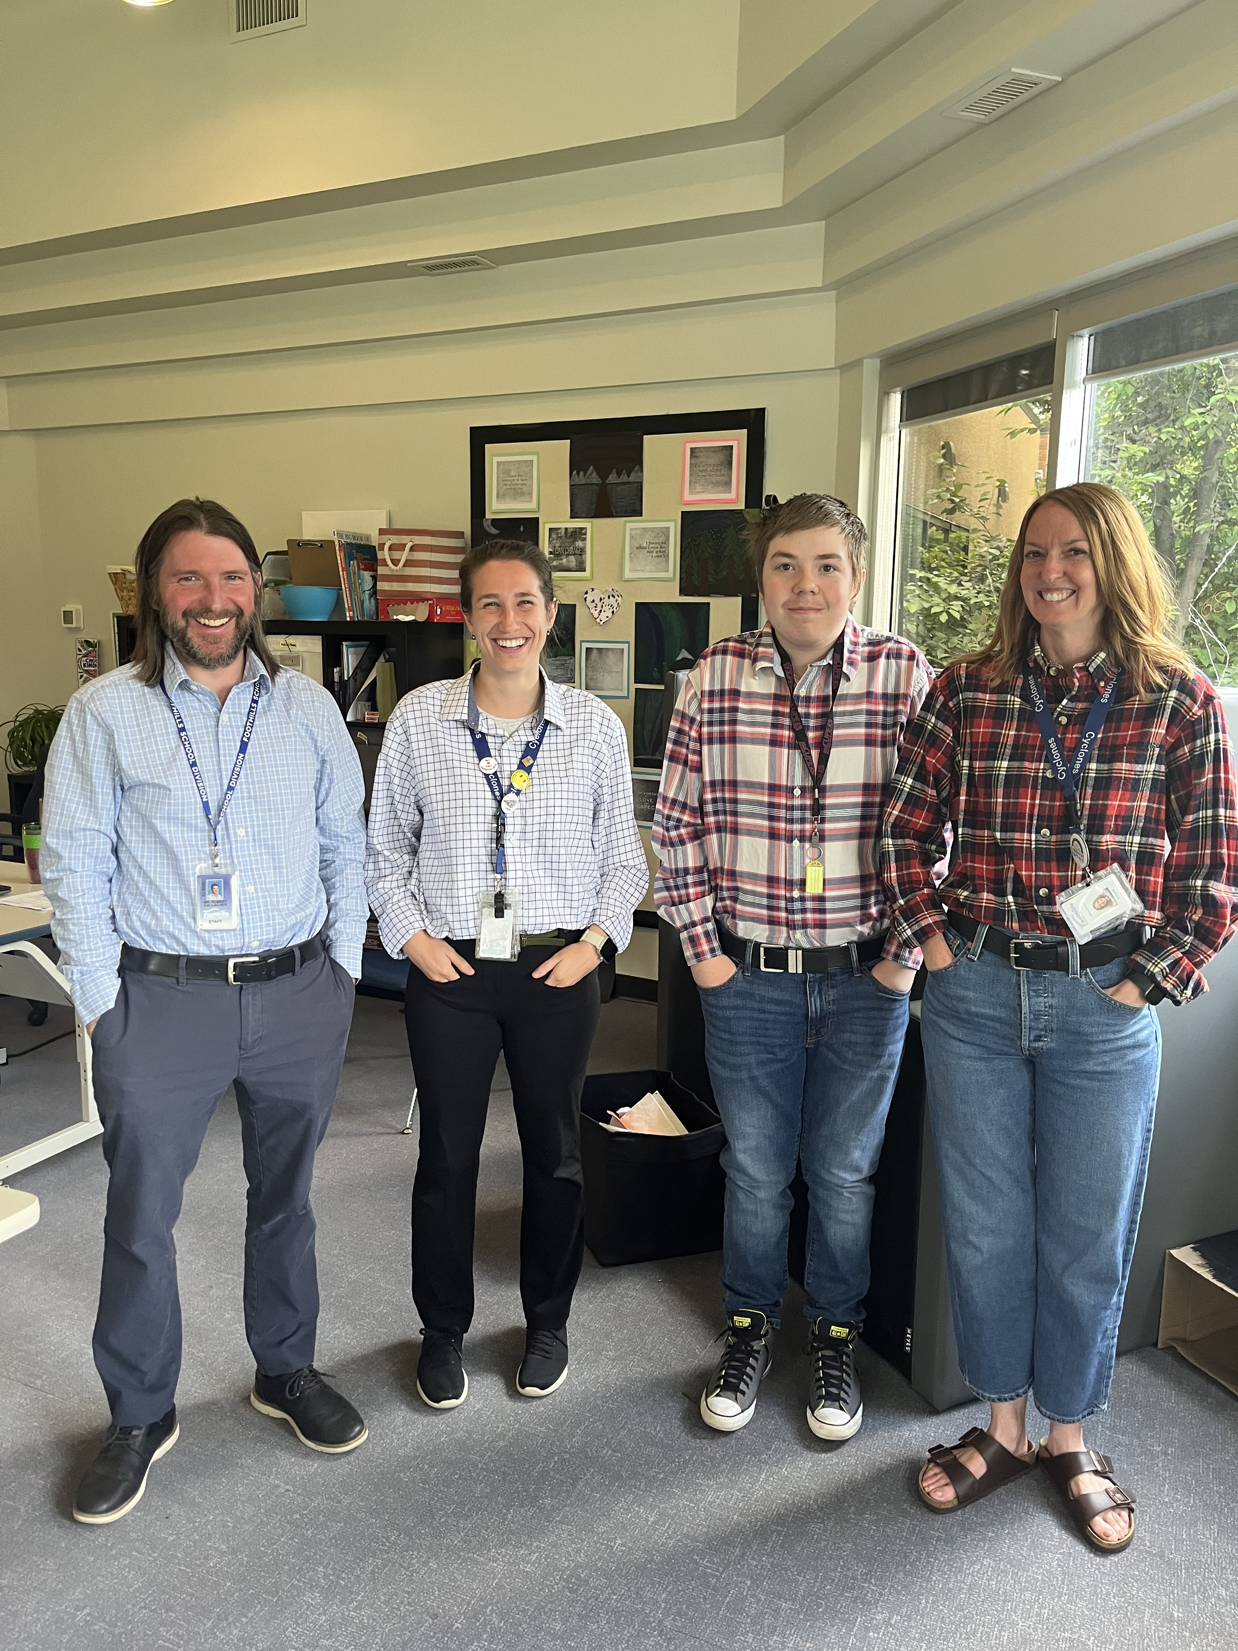
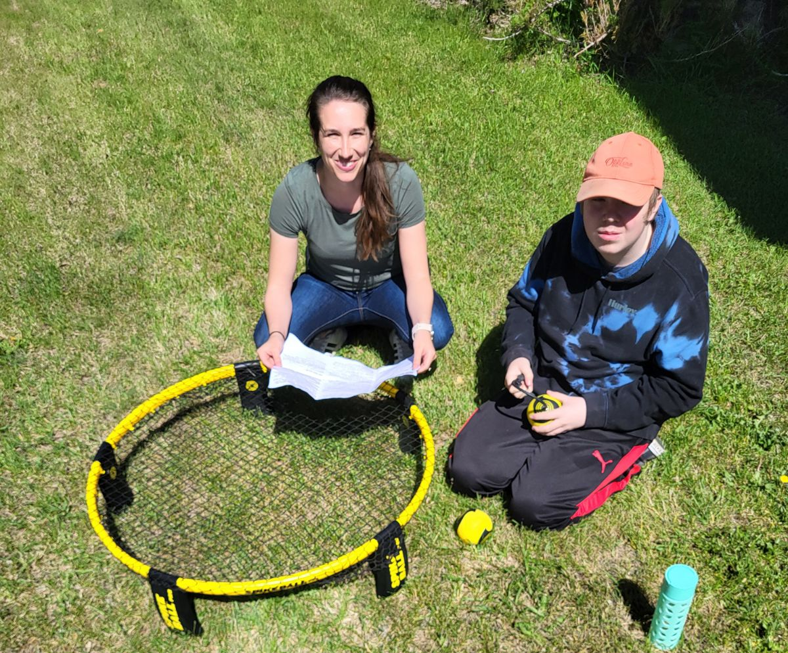

Slide 7
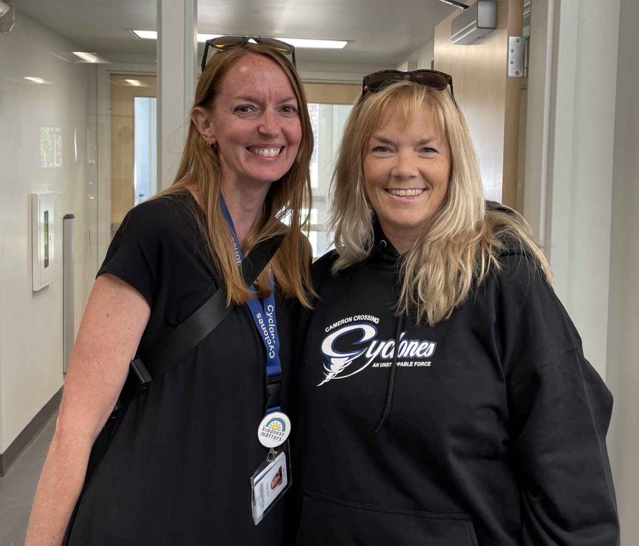
WOW! Time flies when you are having fun, and I cannot believe that it is that time of year. It has truly been a pleasure watching all these amazing young people blossom and grow in their own unique, wonderful way. Thank you for allowing us the opportunity to work with you all in so many ways. Congratulations and best wishes to all our graduates and to those students who will be returning in the fall, we look forward to seeing your faces and hearing all your summer stories. As we are moving into the summer, we would like all of you to remember to be mindful in taking some time for yourself and find gratitude in the little things. We are here in the moment, so embrace it, breathe, and always laugh and smile. If you are looking for some mindful exercises for the summer, here are some suggestions:
1. Mindful breathing - find where your anchor is and focus on that spot
2. Brain Dumps - write down what you need to get out
3. Mindful Appreciation - notice 5 things in the day that usually do unappreciated
4. Read a get book, color, draw - find your calm
5. Get outside - look around, gaze the sky and breathe in fresh air
6. Be KIND to yourselves and enjoy the break.

Slide 8
CC Start-Up Dates
2024/2025 School Year
CC will have a staggered student entry for the beginning of the 2024/2025 school year: ‘Meet & Greet - Welcome Back 2024/2025!’
CC Senior Students Friday - August 30th, 2024 GRADE 12’s & RETURNING GRADE 12’s: 9:00 am to 11:00 am ‘Meet & Greet - Welcome Back’ GRADE 10’s & Grade 11’s: 1:00 pm to 3:00 pm ‘Meet & Greet - Welcome Back’
CC Junior & Senior Students Tuesday - September 3rd, 2024 All CC Students First Day of Full Classes!

