Slide 1


WELCOME TO
FOOTHILLS SCHOOL DIVISION’S
KINDERGARTEN
INFO NIGHT
January 29, 2025
foothillsschooldivision.ca

Slide 2

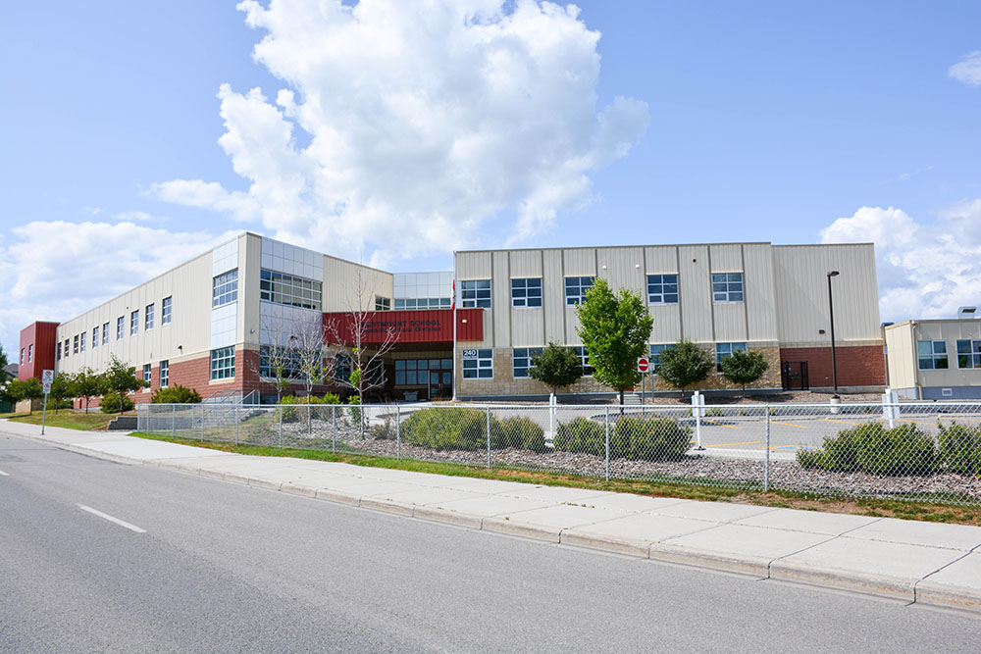

OUR SCHOOL
Westmount School
Kindergarten Entrance/Exit
The "Red" Door

Slide 3
OUR PRIORITIES
Engagement for each learner
Ensure and maintain division-wide engagement that is timely, meaningful and collaborative with all learners and communities.
Support for each learner
Ensure and maintain division-wide learning environments that are welcoming, caring, respectful, safe and inclusive.
Success for each learner
Ensure and maintain division-wide excellence in teaching, learning and leadership.

Slide 4
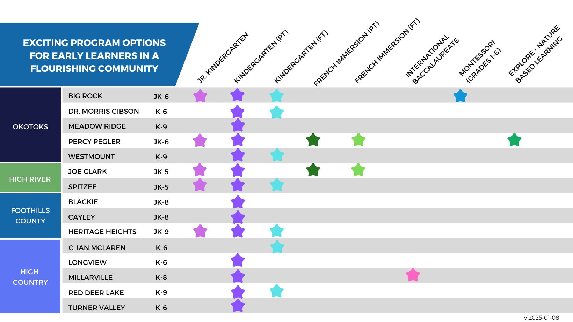

Slide 5


At what age can my child start school?
KINDERGARTEN
JR. KINDERGARTEN
Join us if your child turns 5 on or before December 31, 2025
(Born in 2020)
Join us if your child turns 4 on or before December 31, 2025
(Born in 2021)

Slide 6



OUR KINDERGARTEN PROGRAM
Schedule
Full Time* & Part Time availability
Fees
Full Time Kindergarten: $250/month
Part Time Kindergarten:
$30/year
Part Time Kindergarten is funded by the province. Fees for Full Time cover the salaries and materials associated with the unfunded portion.
Questions?
Explore our website: foothillsschooldivision.ca
Contact us: westmount@fsd38.ab.ca

Slide 7
School Council
A great way to learn more about WMS and stay connected to the school
Opportunity to help with school goal setting, fundraising, and having a voice

Slide 8


DID YOU KNOW...
In the first 5 years, children develop the physical, emotional, and social abilities that will be with them for life.
Notes:
https://open.alberta.ca/dataset/fcbbce6e-d872-4133-a635-71f58dc8c461/resource/bdc66913-9a4f-468d-8449-934fa0b7b949/download/2011-lets-talk-early-years-early-childhood-development.pdf
What happens in children’s earliest years can influence not only their immediate well-being, but also lay the foundation for competence and coping skills that affect learning, behavior and overall health throughout their lifetime. Developing the physical, emotional and social abilities of children is a foundational element of our Jr K and K programs.

Slide 9

KINDERGARTEN
LEARNING PRIORITIES
Learning Priorities are set within the Alberta
Curriculum.
Explore more at LearnAlberta.ca
Foundational Literacy
Social Studies &
Science
Physical Education & Wellness
Fine Arts
Foundational Numeracy
Notes:
https://curriculum.learnalberta.ca/curriculum/en
Insert applicable K slides after this one

Slide 10
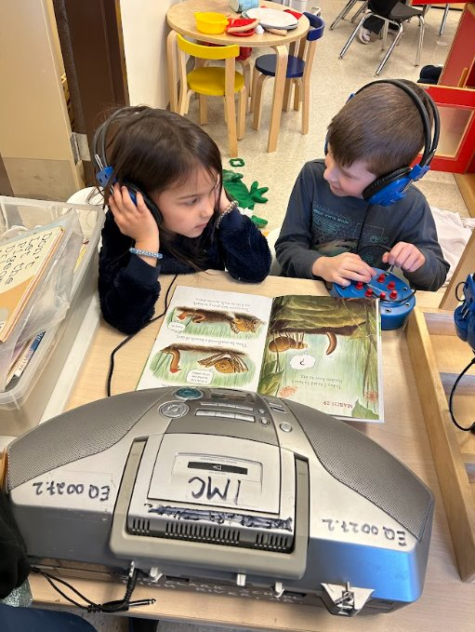
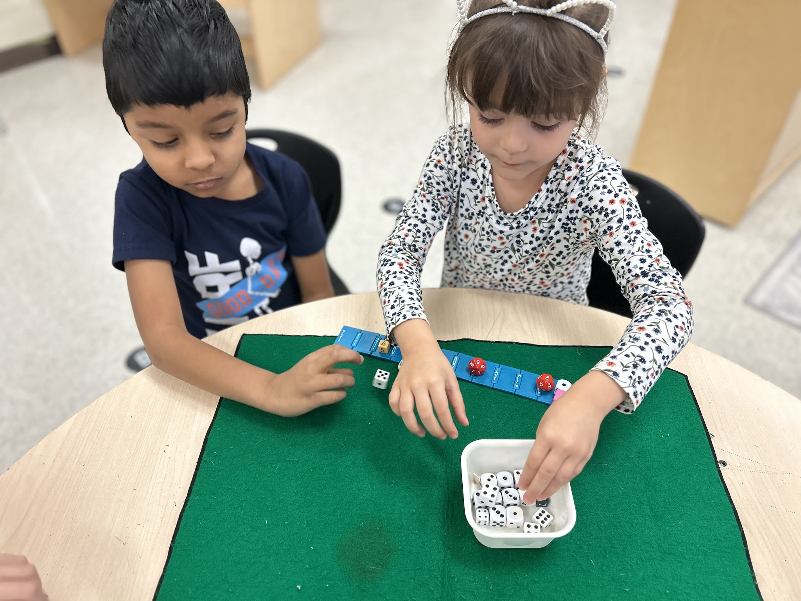
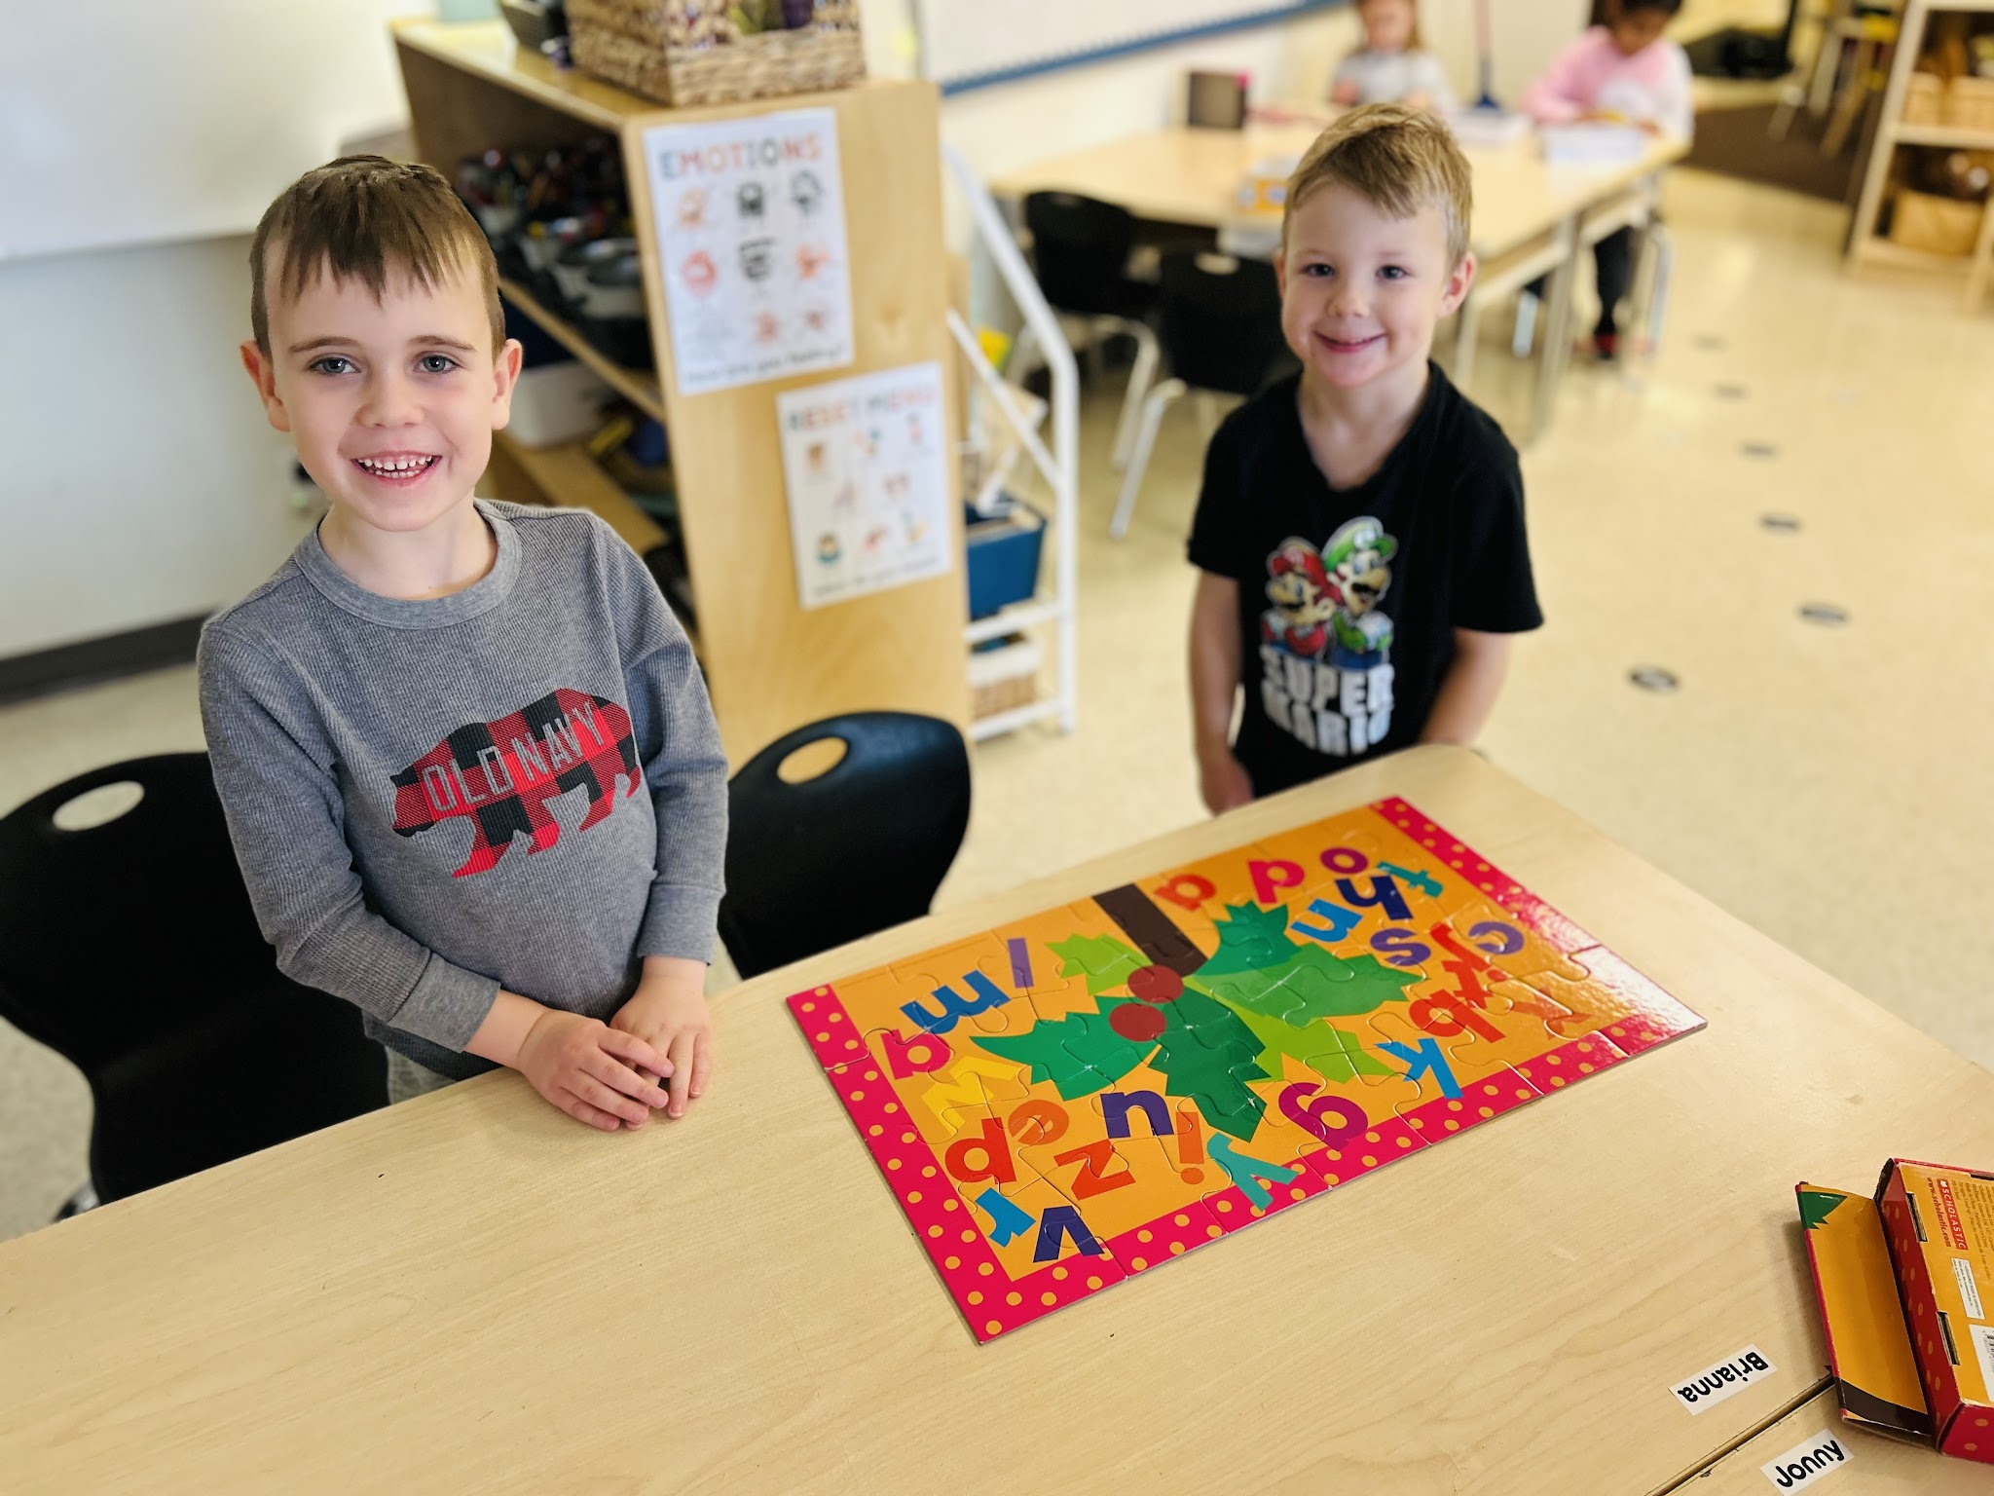
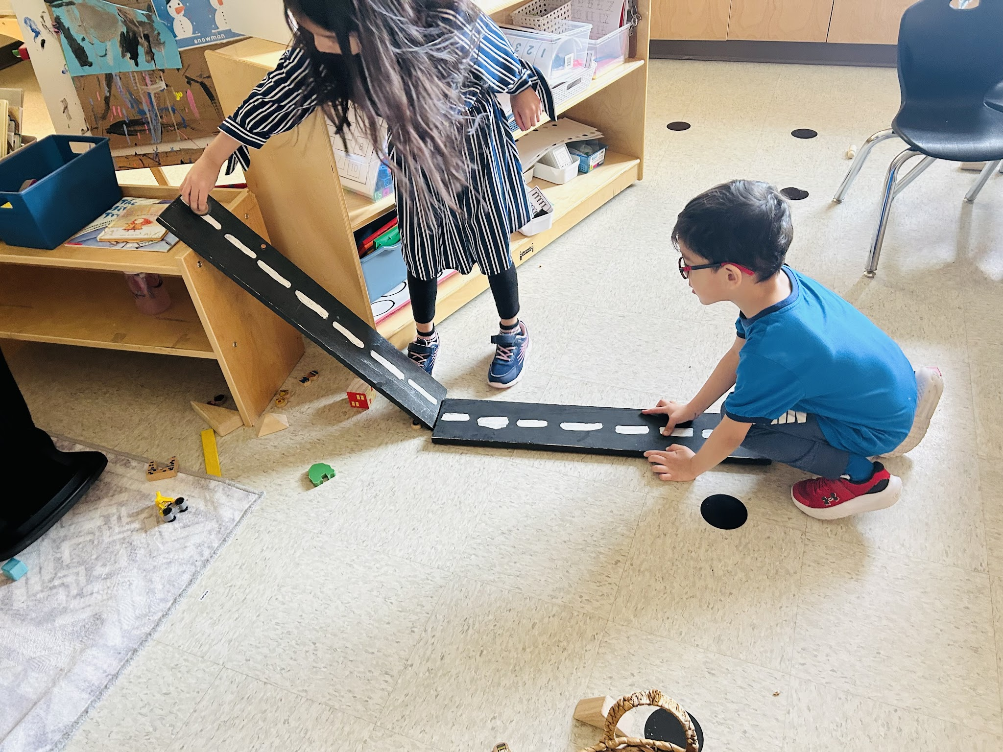
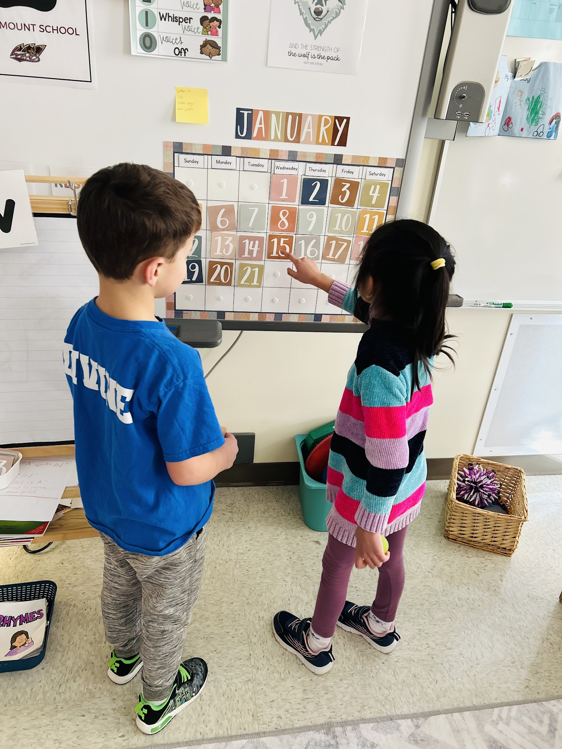
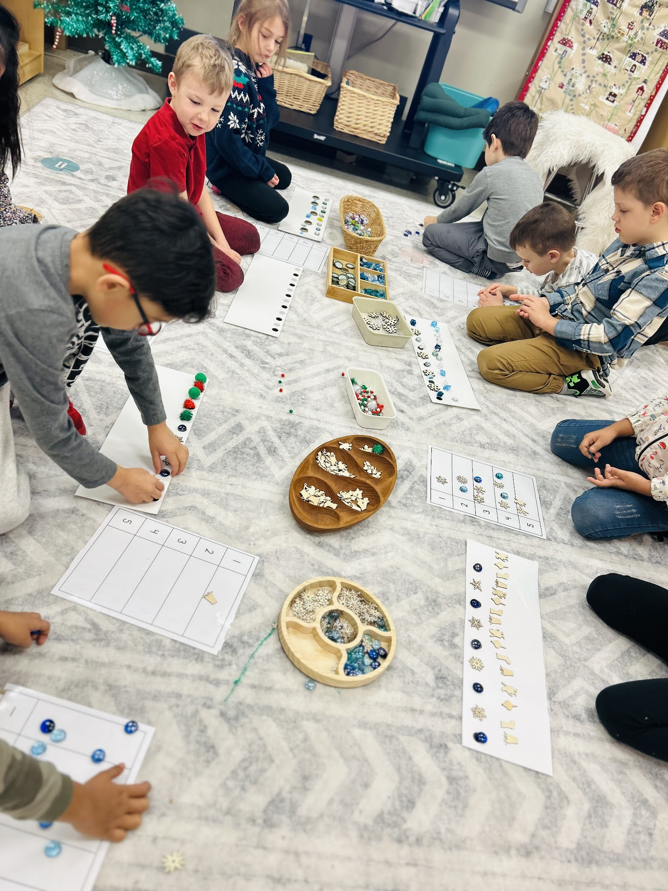
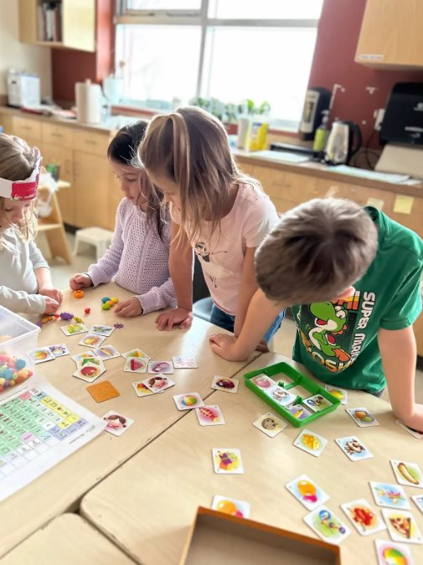
Fostering A Love for
Lifelong Learning
Building a Positive Foundation for Learning at School
Social Interaction
Making Connections & Building Friendships
Collaboration &
Problem Solving
Sparking Curiosity &
Wonder
Structure &
Daily Routines
Safe & Welcoming Classroom Community

Slide 11
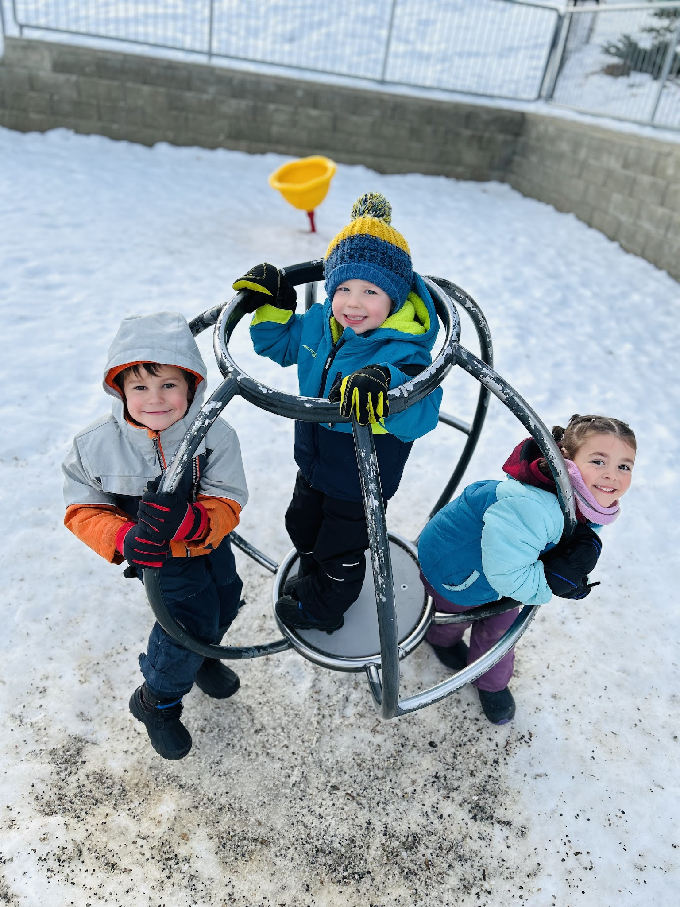
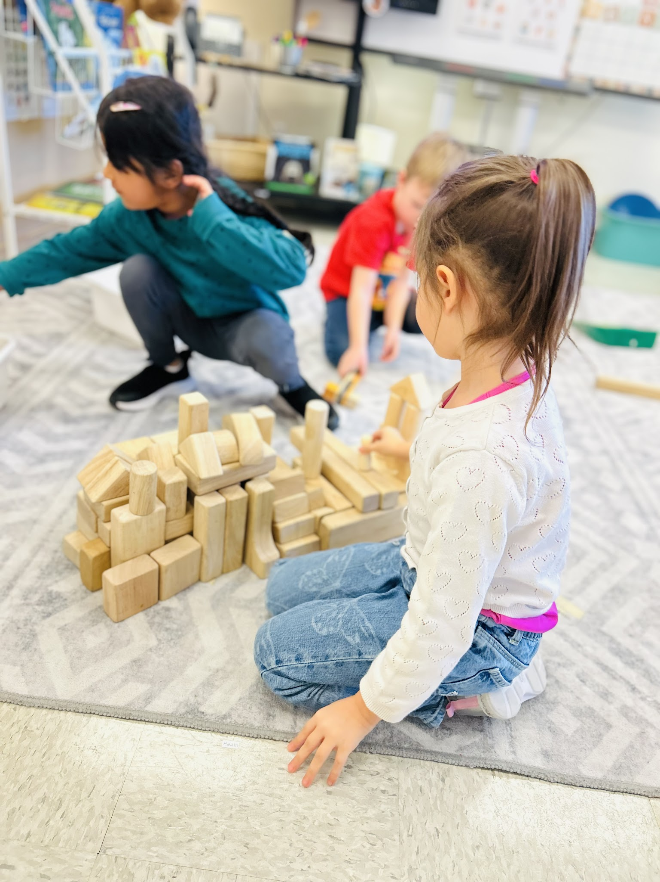
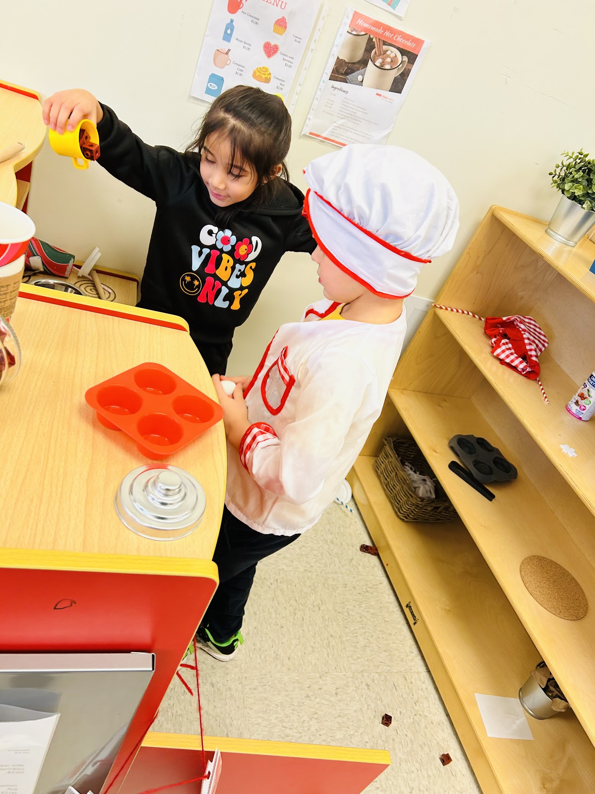
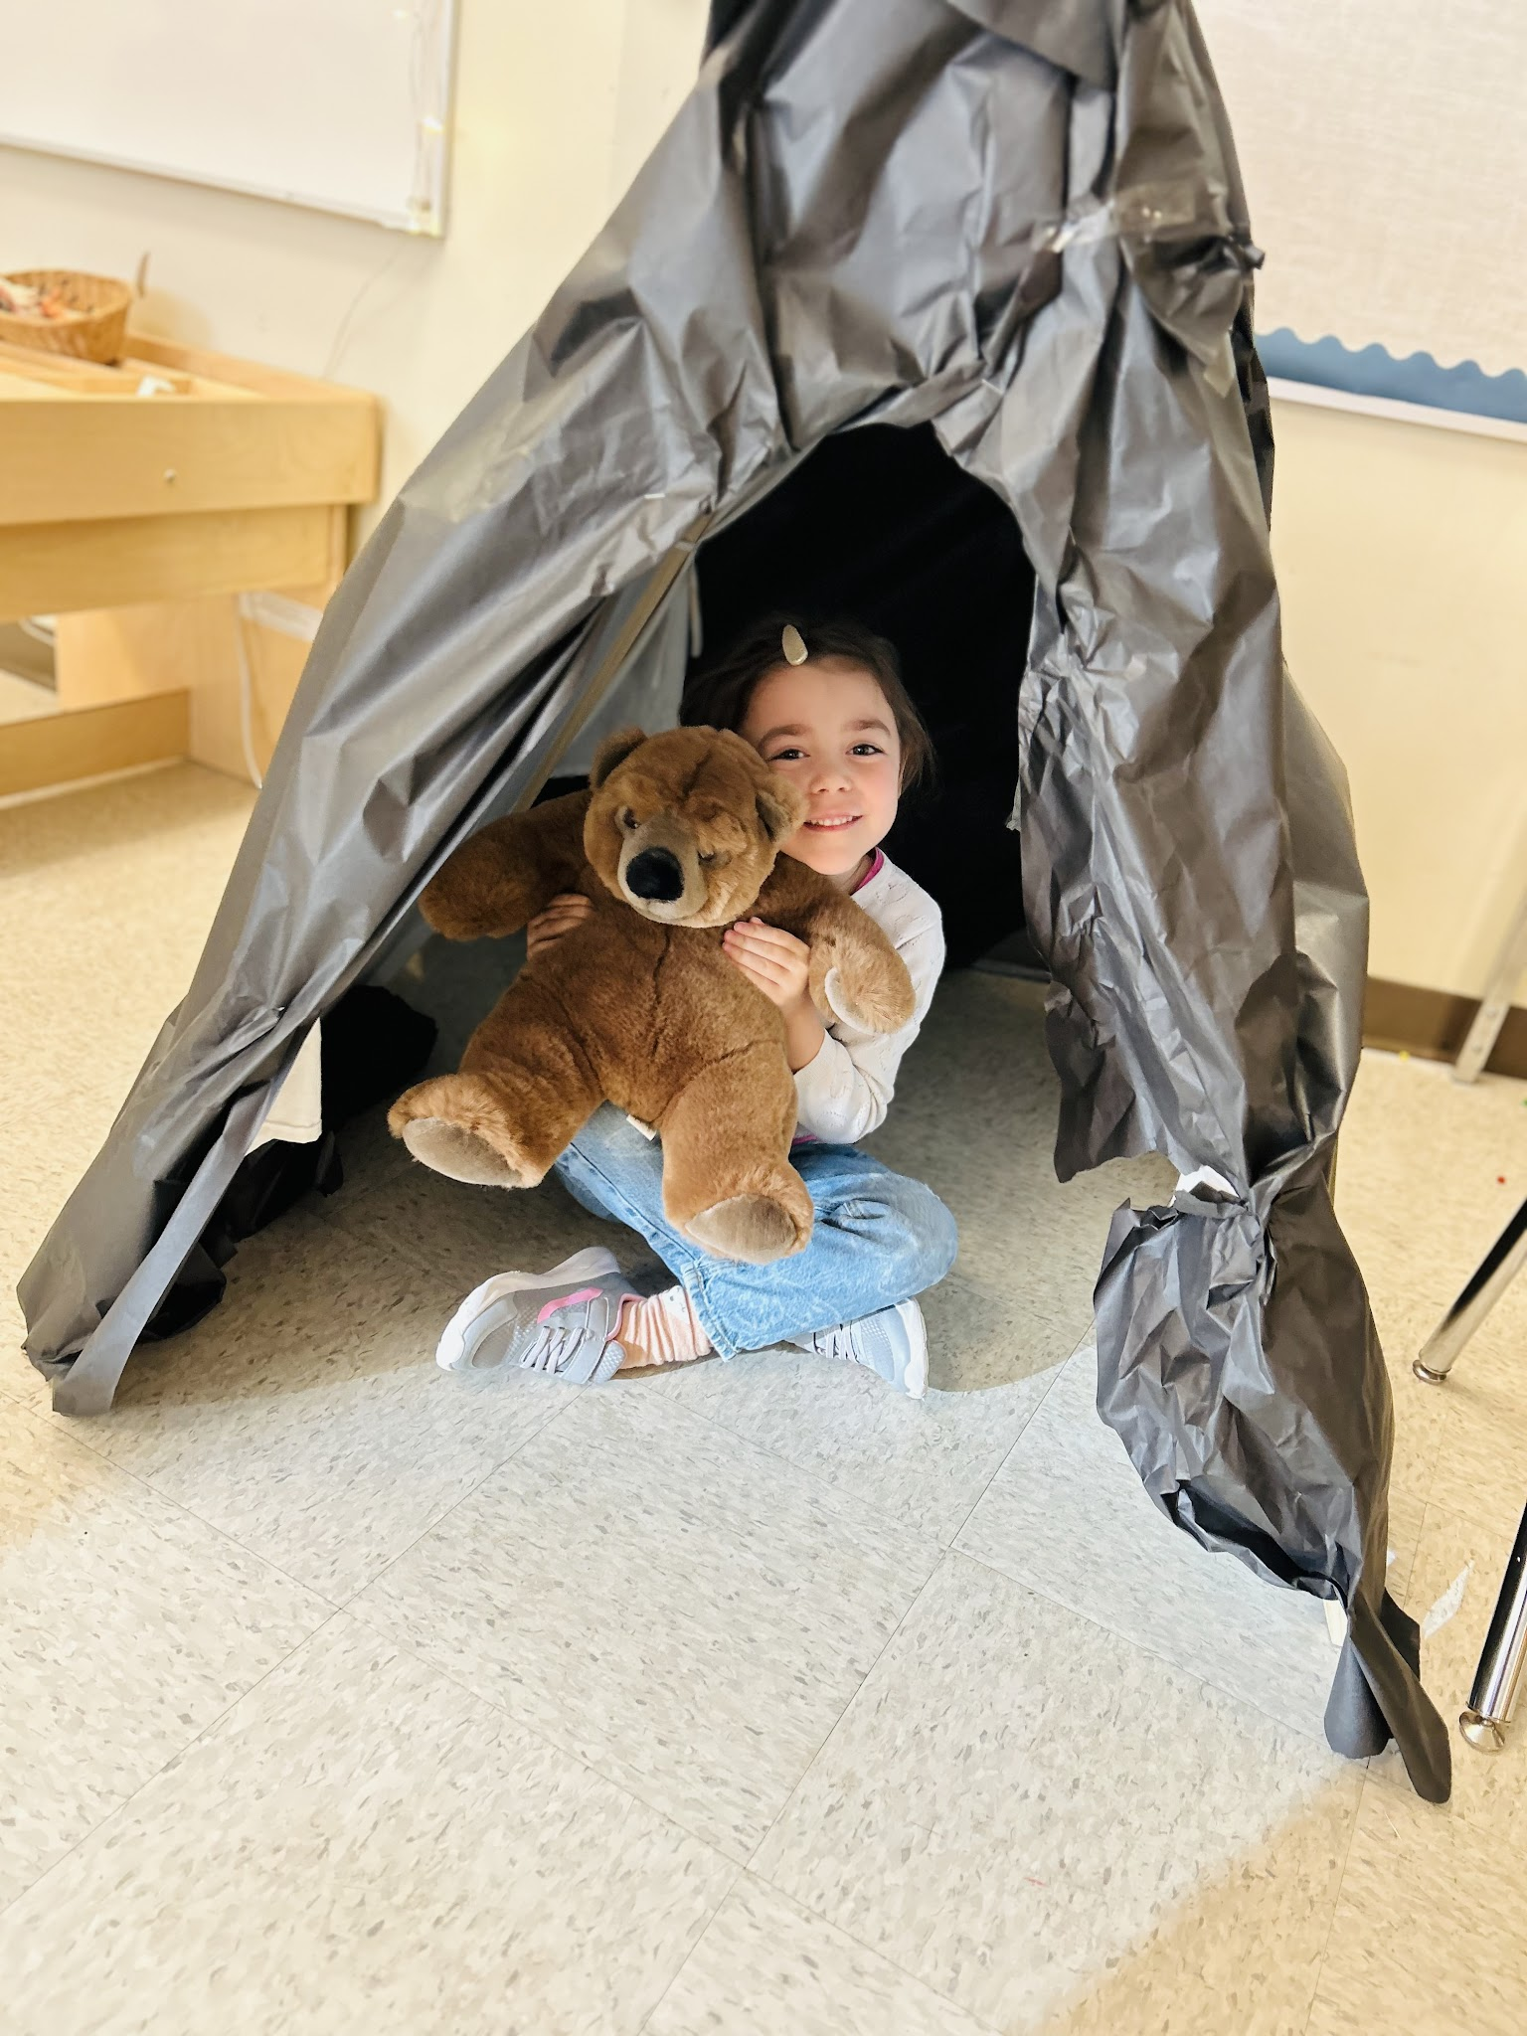
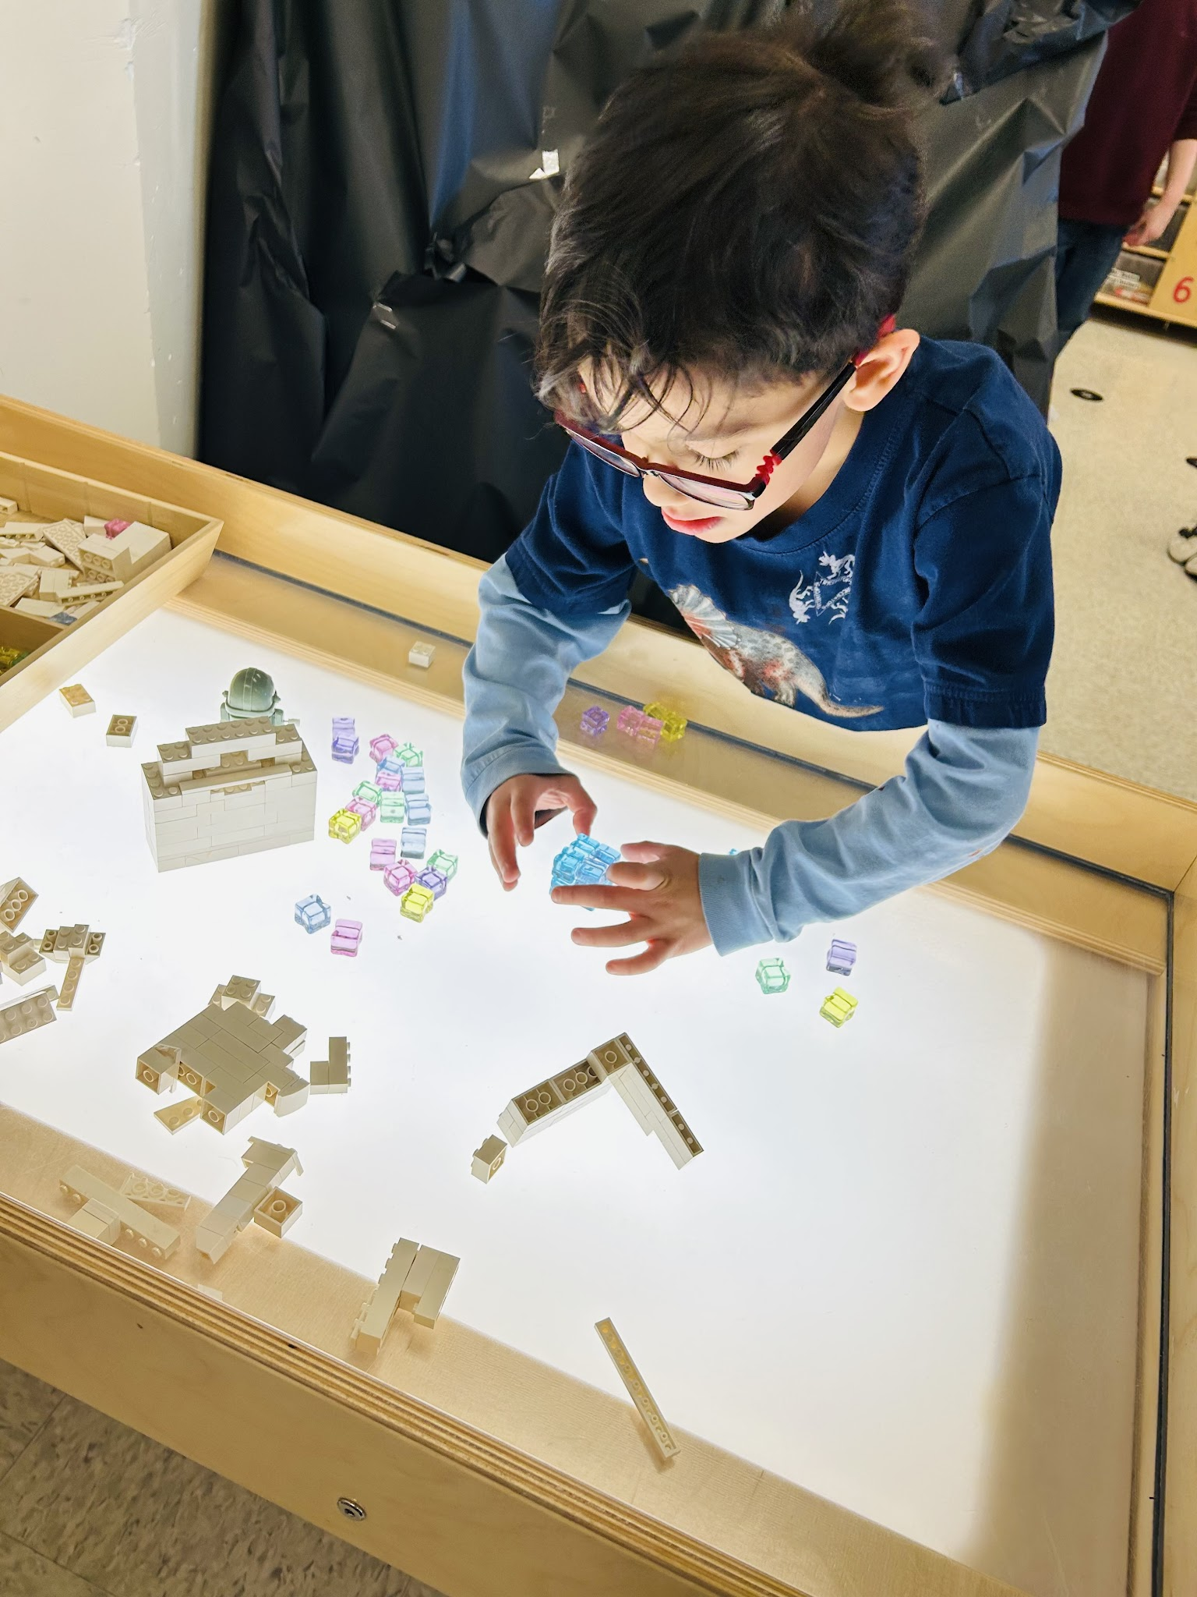
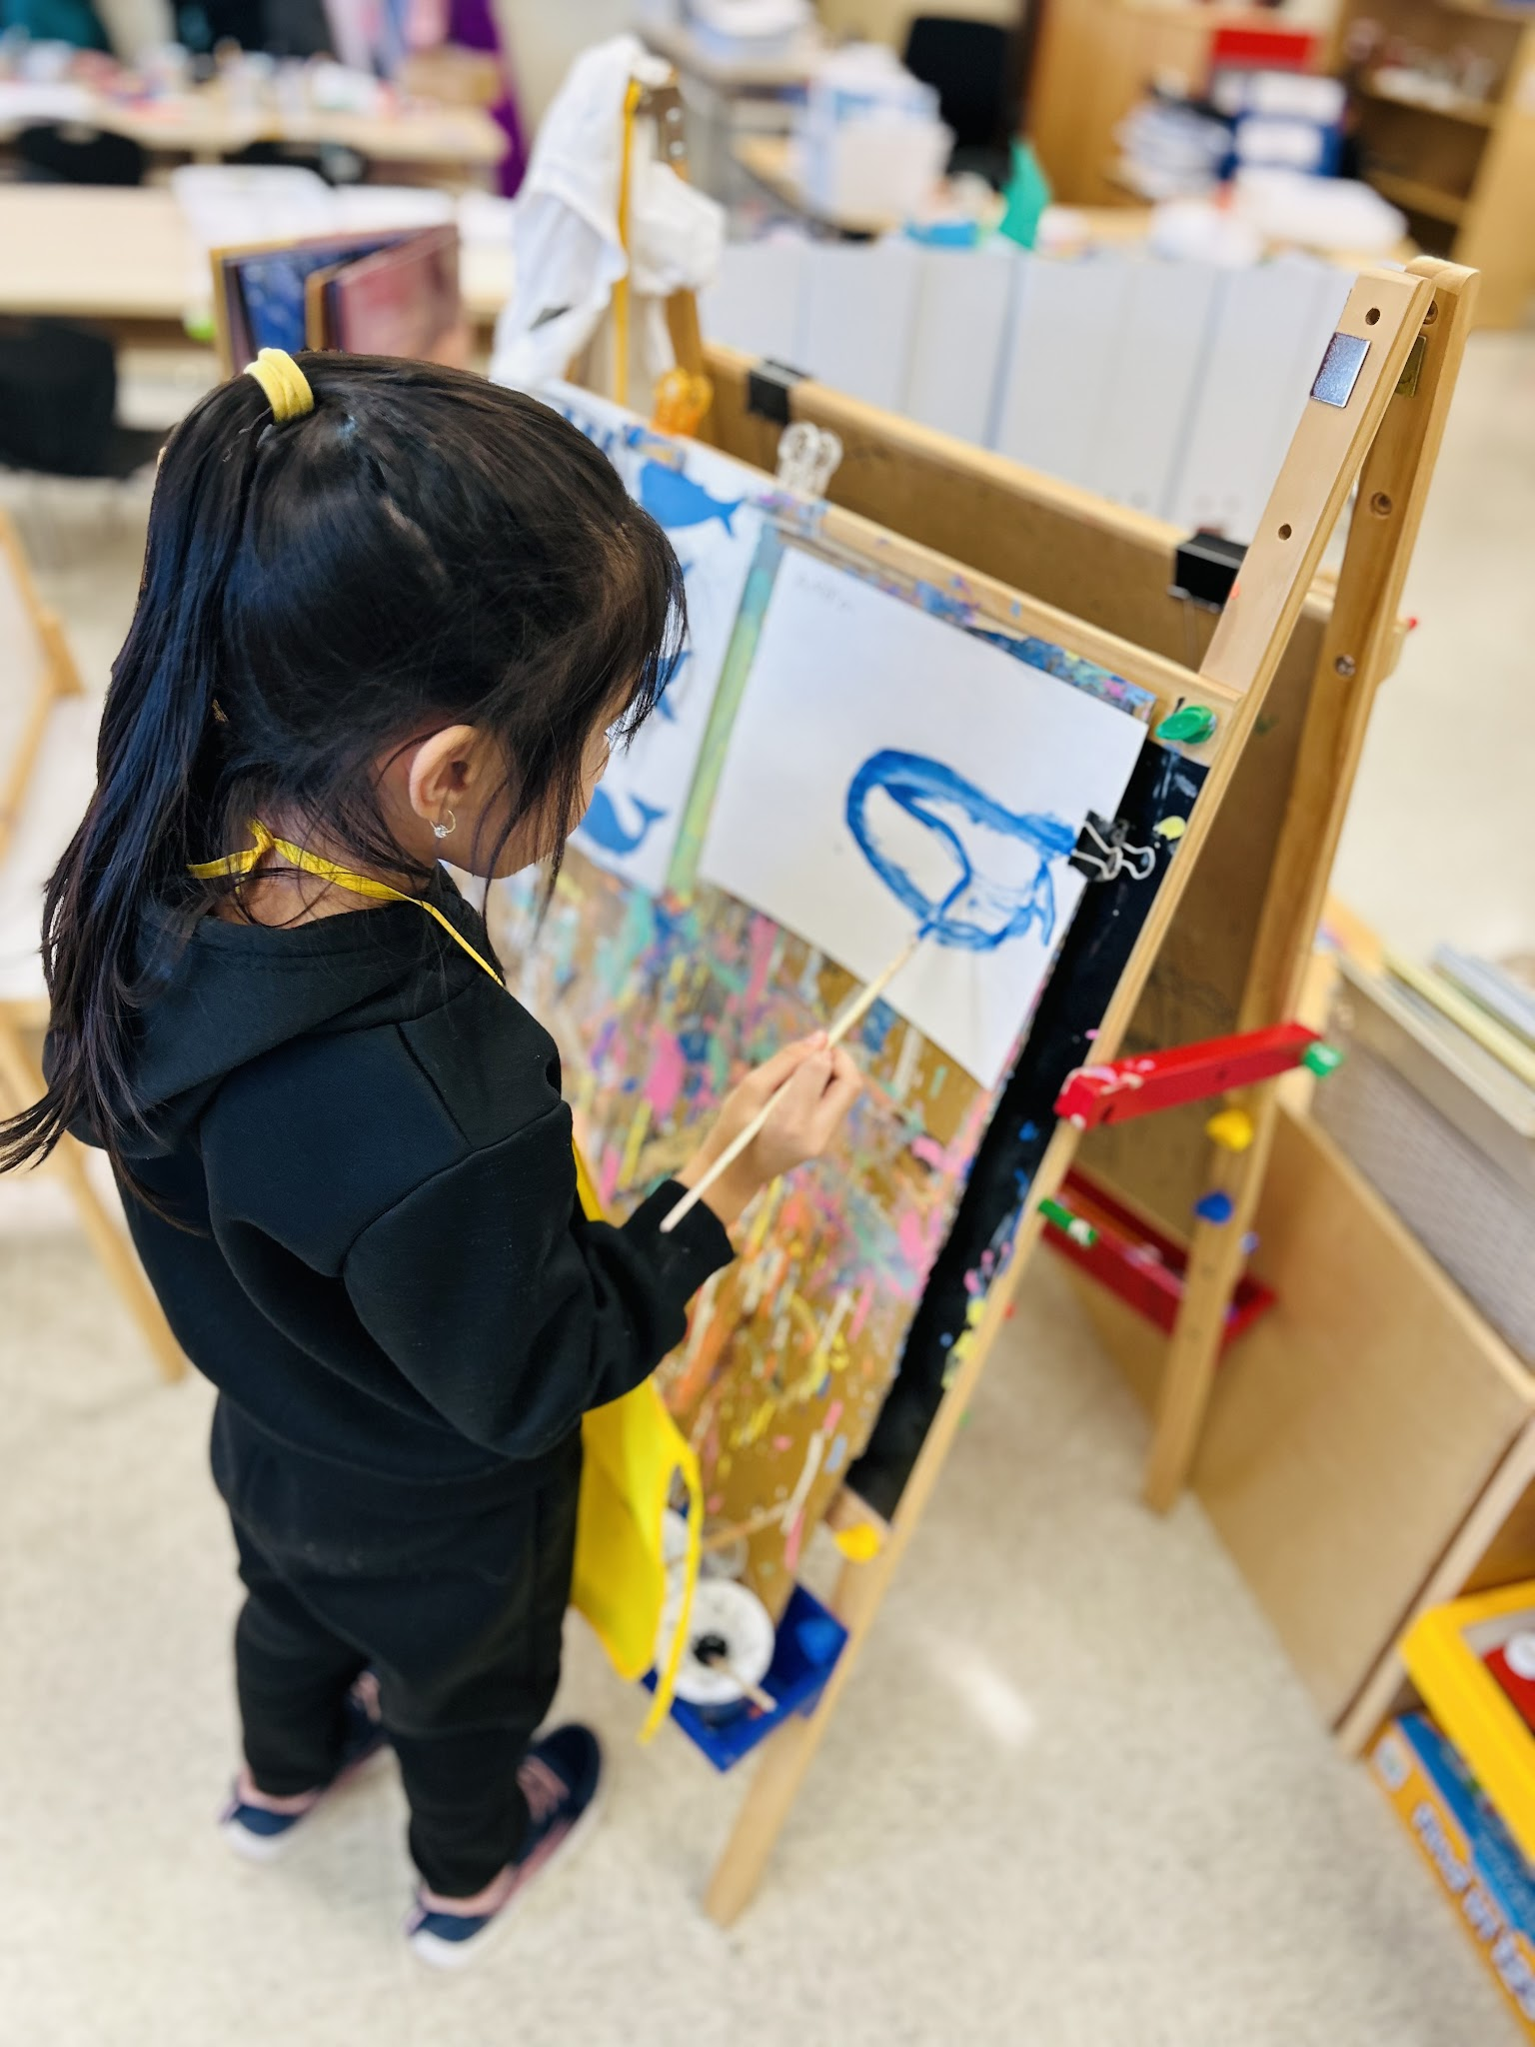
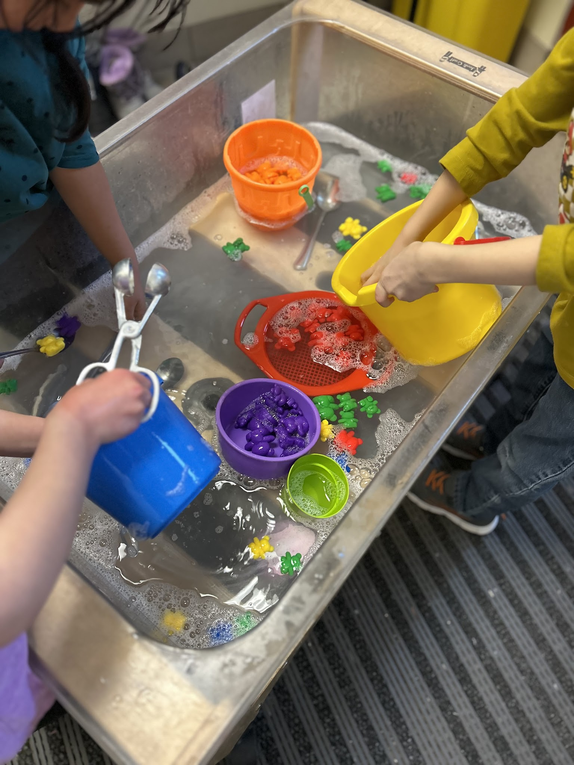
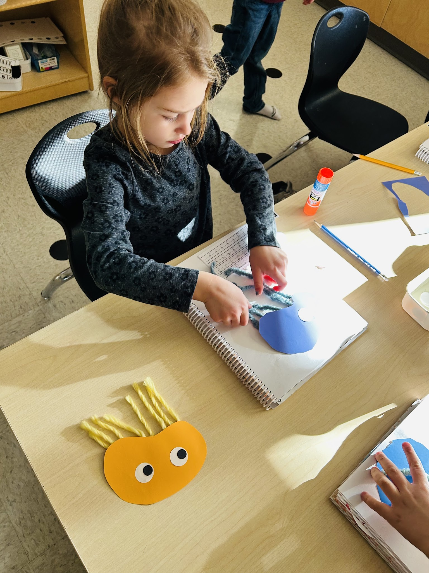
Learning Through PLAY
Building
Engaging Themes
Dramatic Play
Outdoor Play
Dramatic Play
Creative Expression
Embedded Literacy & Numeracy Concepts
Loose Parts
Sensory Play

Slide 12
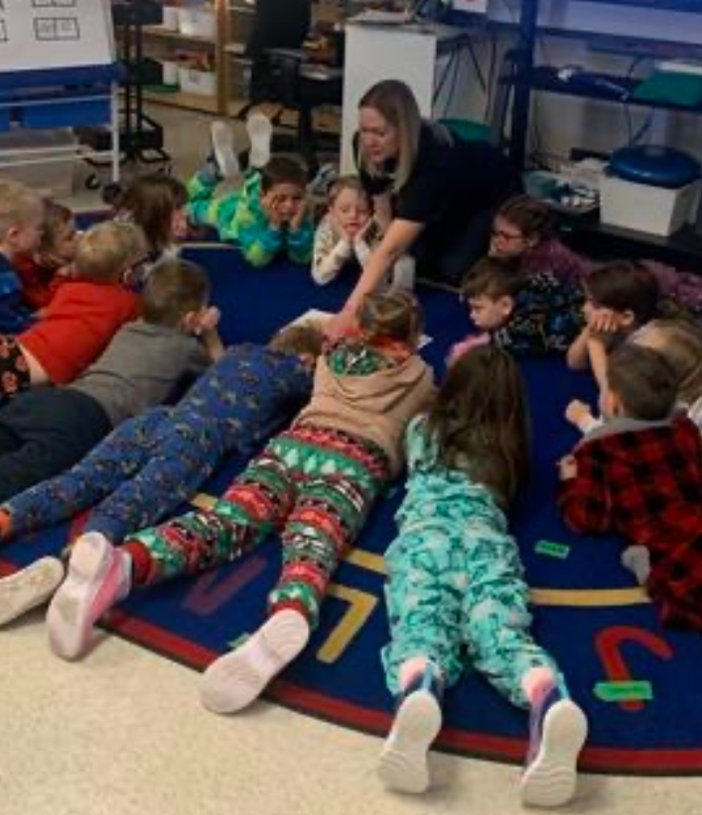
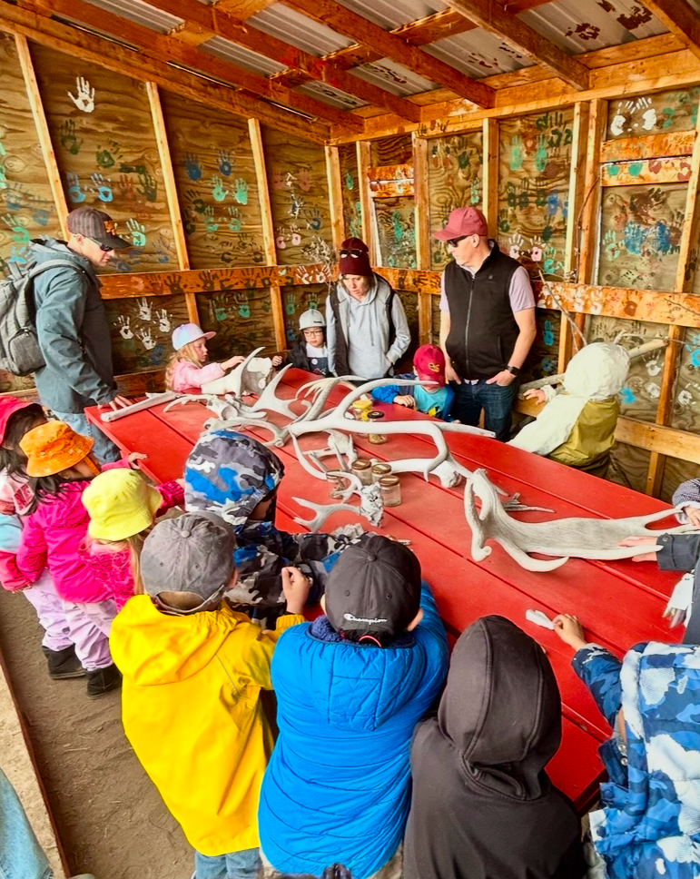
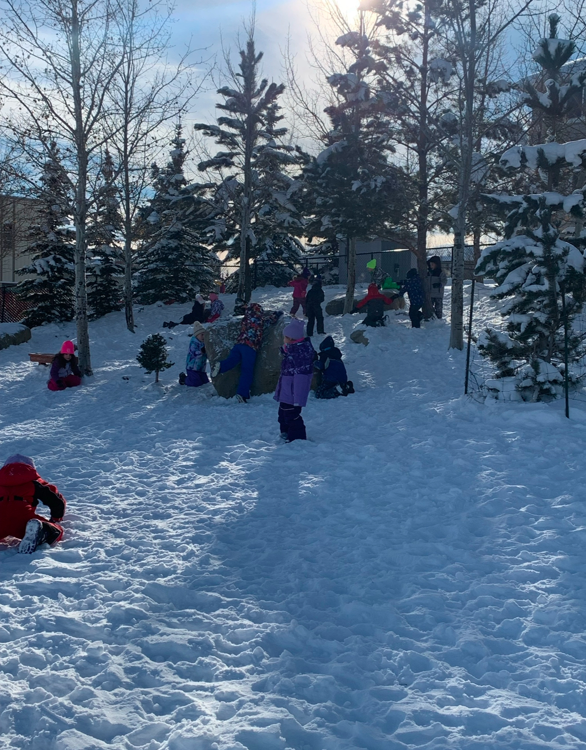
Creating CONNECTIONS and ENGAGEMENT as a team!
FamilyID=Office_ArchiveTorn

Slide 13

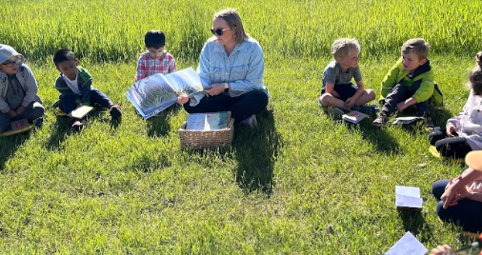
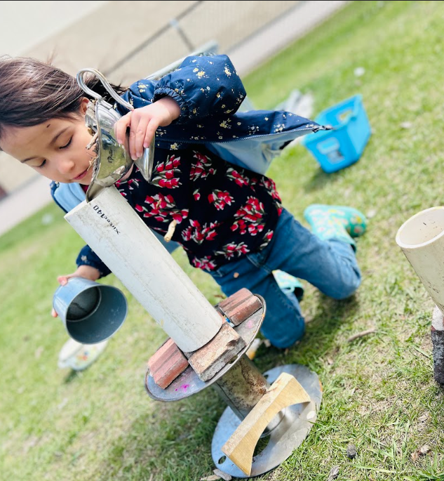
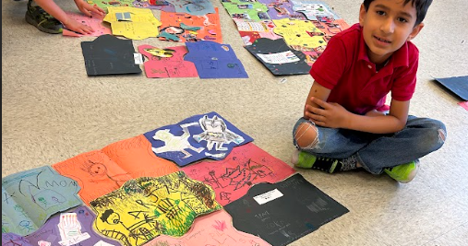
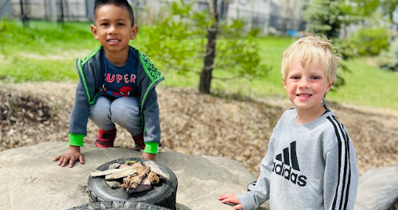
Fostering the JOY of Learning!

Slide 14

Which school do we attend?
The division is organized into Wards and school catchment areas.
Each student has a guaranteed placement within their catchment school.
You can find your catchment school by exploring our Interactive Boundary Map

Slide 15
How will we get to school?
Kindergarten:
If you live 1.6 km or farther from your designated
school you may qualify for busing.
Application Form
Transportation Rules
Transportation Contact & FAQ
Questions?
403-652-6547
FSDTransportation@fsd38.ab.ca

Slide 16

What Supports are available?
We offer a number or combination of the following types of supports:
            Educational Assistants
            Speech & Language Therapists
            Occupational Therapists
            Behavioural Consultant
      Individual Learning Plan (ILP)
    www.foothillsschooldivision.ca/page/97/early-intervention

Slide 17

SUPPORTS FROM
ALBERTA HEALTH SERVICES
Alberta Health Services provides Speech Language (SLP), Occupational Therapy (OT) and Physiotherapy consultations and support for children aged 0-5.
Parents can connect to access a "Speech Chat" with an AHS Therapist by calling: 403-995-2638.
Rural Pediatric Allied Health at the Okotoks Wellness Centre offers several supports for child development.
Visit AlbertaHealthServices.ca for more information

Slide 18
HOW YOU CAN HELP YOUR CHILD GET READY FOR SCHOOL
Read books together every single day and point to the words. Ask questions about the story, too!
Develop fine motor skills (how to hold a pencil, use scissors, play with playdough)
Follow 2-3 step instructions
Practice letters and letter recognition
Find letters/numbers in the environment
Count with concrete items (toys, rocks, Lego)
Build your child’s self esteem with praise, hugs and listening.
Help your child take responsibility (cleaning up toys, using the bathroom, getting their own healthy snacks)
Notes:
Read books everyday! Read books about school, join the library.
Develop fine motor skills: holding a pencil, colouring, cutting with scissors and playing with playdough. Practice zippers and buttons!
Develop 2-step directions: “Please go get your shoes and put them on.”
Explore directional words such as over, under, in front, behind, between.
Talk about social skills: sharing, taking turns, using positive words, talk about handling frustration.
Help your child take responsibility: clean up messes, dress themselves, open their own snacks or snack containers. Have them practice using the water bottle/lunch kit/containers to help build independence.
Practice number recognition: count objects, identify numbers.
Practice letter and sound recognition: practice saying the letters and the sounds. What do the Letters Say?
Discuss what your child will do in school: meet new friends, have play time, colour, draw, cut, make crafts, play outside, etc. Talk positively about school.
Build self esteem! Praise your child often and be patient when your child is learning a new task. (Adapted from notjustcute.com)

Slide 19
HELPFUL RESOURCES
Developmental Milestones
I am ready for Kindergarten:
Book
Tips and resources
I am Ready for Screens Book
Resources Galore:
9 Things to do this Winter
Getting Ready for Kindergarten
Age 5 Activities

Slide 20


How do we register?
All registrations are completed online.
Proof of child’s age and residence is required to complete registration.
Families new to FSD will need to register for an Edsembli Account.
If you already have a Family Portal account, you can register your child through your existing portal.

Slide 21

KINDERGARTEN REGISTRATION
1. Register Online
2. Help us learn more about your child
Strong Start Survey
Ages & Stages Questionnaire (ASQ)
3. Ready to Learn Open House – May 16th 1-3pm

Slide 22

Registration: NEXT STEPS
Ready to Learn
Strong Start Survey
Once you have registered you will receive an email from your child’s school with a link to the Strong Start Survey.
This survey is to help us get to know your child and gather information to assist in the overall planning for our kindergarten programming.

Slide 23
Registration: NEXT STEPS
Ready To Learn
Ages & Stages Questionnaire
Parents are partners in education.
The next stage of getting to know your child is through the Ages and Stages Questionnaire (ASQ)
What is the ASQ?
The ASQ is a parent-led activity to help you answer questions in 5 domains:
Language and Communication
Gross Motor Skills
Fine Motor Skills
Problem Solving
Personal / Social Interaction
Questions about the ASQ?
Contact Dinah VanDonzel, Director of Student Learning (JK – 6) at StudentLearning@fsd38.ab.ca

Slide 24
NEXT STEPS
Ready to Learn Open House
This spring, our school will be hosting a Ready to Learn Open House on Friday, May 16th, 2025, between 1:00 – 3:00 PM.
(TIME SLOTS will be communicated).
Please bring any documentation or assessments about your child on this day.
This time slot will be for you and your child to meet our teachers, become acquainted with the school, and allow us the opportunity to observe your child in a learning environment. More information to come!
Registration
Registering early allows us to determine class schedules and staffing for our Kindergarten programs – Full Time and Part Time.

Slide 25
WHAT TO EXPECT FROM US
Communications are sent to the email used at registration
Confirmation
Registration confirmation
Strong Start Survey
ASQ
Program confirmation
Invitation
Ready to Learn Open House
Welcome
A note from your child’s teacher and what to expect in the classroom.
Information for the first day of school
Full time Kindergarten is subject to enrollment capacity by April 30

Slide 26
THANK YOU
Explore More
We welcome you to explore our division and school websites at to learn more about our philosophy and learning opportunities.
www.foothillsschooldivision.ca
www.foothillsschooldivision.ca/westmount
Contact Us
Sherry Opas, Principal
OpasS@fsd38.ab.ca
Brad Skeet, Vice Principal
SkeetB@fsd38.ab.ca
westmount@fsd38.ab.ca
(403) 995-4824
Follow Us
Instagram: @WestmountFSD

