Slide 1
Welcome to the Foothills School Division!
Kindergarten Open House and Registration Night
January 31st, 2023

Slide 2
FSD’s Priorities
Optimum learning is achieved through our priorities
Engagement for each learner
Ensure and maintain division-wide engagement that is timely, meaningful and collaborative with all learners and communities.
Support for each learner
Ensure and maintain division-wide learning environments that are welcoming, caring, respectful, safe and inclusive.
Success for each learner
Ensure and maintain division-wide excellence in teaching, learning and leadership.

Slide 3
Westmount School Council
School
Parent
Child

Slide 4
Did you know...
“In the first 5 years, children develop the physical, emotional, and social abilities that will be with them for life.”
Notes:
Lauren
https://open.alberta.ca/dataset/fcbbce6e-d872-4133-a635-71f58dc8c461/resource/bdc66913-9a4f-468d-8449-934fa0b7b949/download/2011-lets-talk-early-years-early-childhood-development.pdf
What happens in children’s earliest years can influence not only their immediate well-being, but also lay the foundation for competence and coping skills that affect learning, behavior and overall health throughout their lifetime. Developing the physical, emotional and social abilities of children is a foundational element of our Jr K and K programs.

Slide 5
Kindergarten
Learning Priorities
Foundational Literacy
Citizenship & Identity
Environmental & Community
Awareness
Physical Education & Wellness
Fine Arts
Foundational Numeracy
Notes:
Lauren and Natasha
https://curriculum.learnalberta.ca/curriculum/en

Slide 6
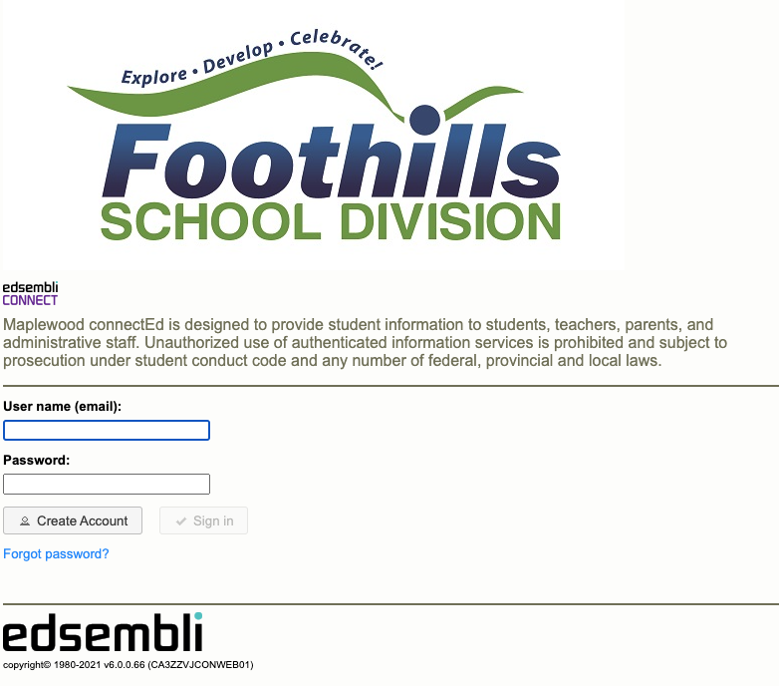
How to Register
Please note we do not offer full-time kindergarten at WMS.
Click Here for full registration information
If you are having problems with online registration, please call the office at 403-995-4824.
Step 1: Click Here
Step 2: Create a new account or sign in if you already have one
Step 3: Complete the registration form
You will need:
Child’s proof of citizenship (e.g. birth certificate)
Notes:
Brandy
Link to PP to be posted on website next week
Lauren M/Natasha to email calendar near the end of the school year with welcome letter
Date preference asked after registration when Brandy calls home to arrange a screening day/time. An email confirmation will be sent once we ensure balanced classes taking into consideration size, needs, available supports etc… We try the best we can to make preferred dates work and appreciate the flexibility of those who can make either choice work
Staggered start day to be set based upon which days your child will be attending and shared out when set

Slide 7
Busing
At this time, we are unsure about the busing for our school. We would recommend that you reach out via email to transportation as we get closer to the new school year.
Application Form
Transportation Rules
Transportation Contact & FAQ
Questions?
T: 403-652-6547
E: Transportation@fsd38.ab.ca
Notes:
Brandy – Recommend to go to the links as there are fees associated with bussing that you should be aware of, specifically if you are less than 2.4 km

Slide 8
Kindergarten at Westmount School

Slide 9
How you can help your child get ready for school
Read books together every single day and point to the words. Ask questions too!
Develop fine motor skills (how to hold a pencil, use scissors, play with playdough, colour, use stickers)
Develop communication skills and use of words
Follow 2-3 step instructions
Practice letters and letter recognition, name recognition
Find letters/numbers in the environment
Count with concrete items (toys, rocks, Lego)
Build your child’s self-esteem with praise, hugs and listening
Help your child take on responsibility (cleaning up toys, using the bathroom independently/without support)
getting/opening their own healthy snacks, getting dressed independently)
Notes:
Natasha

Slide 10
Supports from Alberta Health Services
Alberta Health Services provides Speech Language (SLP), Occupational Therapy (OT) and Physiotherapy consultations and support for children aged 0-5.
Parents can connect to access a "Speech Chat" with an AHS Therapist by calling: 403-995-2638.
AHS offers OT/PT/SLP drop-in clinics out of the Okotoks Wellness Centre
Notes:
Amy – ***please provide any reports etc… you may have (Psych, Medical, OT/PT/Speech to the school upon registration

Slide 11
Social Emotional Supports
Alana Hauszner FSLC
Introduction
How to work up to transition to school
Social Skills (Play Skills)
Regulating Emotions
Zones of Regulation/Mindfulness (Language that will be introduced)
Support through week 1
Notes:
Alana
FSLC provides short term counseling, small group skills training, and universal classroom supports around social-emotional learning, along with connecting caregivers to outside agencies for long-term supports.
To help your child prepare emotionally and socially for kindergarten you can:
Visit the school throughout the summer and play at the school park. Try reading books related to starting school and show enthusiasm for the new experience.
Start school routines early to increase comfort.
Provide opportunities to develop social skills through play dates away from parents, helping them resolve conflict with their words, practice following directions like they would in their new classroom etc…
Role model positive ways to cope with changes. Children learn from the adults around them. Show your child how you manage changes.
Talk about activities your child will do at school like play Lego and make new friends, and how they’ll learn new skills like reading and writing
Create a good-bye ritual and stick to it. Keep it short and sweet so your kiddo isn’t preoccupied with your presence.
Celebrate successes, not matter how small to instill a sense of confidence. "Kids can do hard things".
Zones of Regulation – a social-emotional curriculum that support children with developing self-management skills. Your child will be learning about their emotions and strategies that they can use when they have a big feeling.
To help your child prepare for zones you can help them to name their feelings and find appropriate ways to express these feelings.

Slide 12
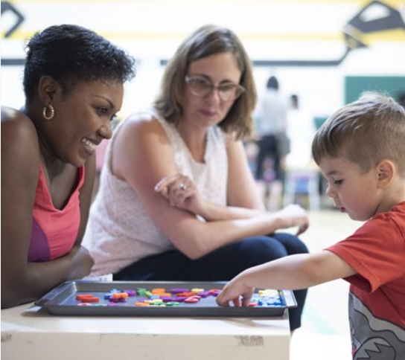
The Learning Partnership
In the Spring:
You will be invited into our school to play and learn with your child. We will play games, have fun, and share a Welcome to Kindergarten package with you!
We will share more information when we see you for kindergarten screening
Notes:
David
Kindergarten students are normally assessed in 5 areas. As we are unsure if screening will occur online or in person, we don't know if we will assess all 5 areas or not.
If we are screening online, we will focus in on 2 areas (#2, #3), indicated below.
Awareness of Self & Environment (understanding the world)
Cognitive Skills (letters & sounds, counting)
Language and Communication (including listening, full sentences)
Physical Development (fine and gross motor)
Social Skills / Approaches to Learning (taking turns, following rules, playing with others)

Slide 13
Thanks!
For further questions you may contact Brandy at the WMS office
(403) 995-4824
westmount@fsd38.ab.ca
Please keep this slide for attribution

